Slide 1
Medical Eligibility
Verifications
Notes:
Welcome participants to the training session.
Cover any housekeeping items such as:
The location of restrooms and break rooms.
Ground rules for the training.
Instructor introductions.
Participant introductions.
Transition: Let’s talk about why we’re all here.

Slide 2
Medical Eligibility: Verifications
Introduction
After completing this course, you will be able to:
Recognize shared and unshared verifications
Record Verification values
Identify Source values
Locate the Verification List page
Generate a Verification Request form
Process verifications received from a consumer

Slide 3
Medical Eligibility: Verifications
Agenda
Lesson 1: Verification Fields
Lesson 2: Verification Options
Lesson 3: How EDBC Rules use Verifications
Lesson 4: Verification List Page
Lesson 5: Request Verification Form
Lesson 6: Verification Received

Slide 4
Medical Eligibility: Verifications
Lesson 1: Verification Fields > Shared and Unshared
Most data collection screens have verification fields which capture whether the information entered has been verified. Some verified data is shared between programs and agencies. Other verifications are separated.
An example of data that is separate is income. The user will select the program (Family Medical vs. Elderly and Disabled) to which the income applies before verifying the income.
Notes:
Shared data is common data for the individual that is used in KEES for medical and non-medical programs.
Since much of the information captured in KEES is person specific (not case specific) it was necessary to decide which verifications could be shared between agencies and which verifications needed to remain separate.
NOTE: Interface data from Social Security will display as Family Medical income. Follow your agency’s policy regarding how to handle this income type.

Slide 5
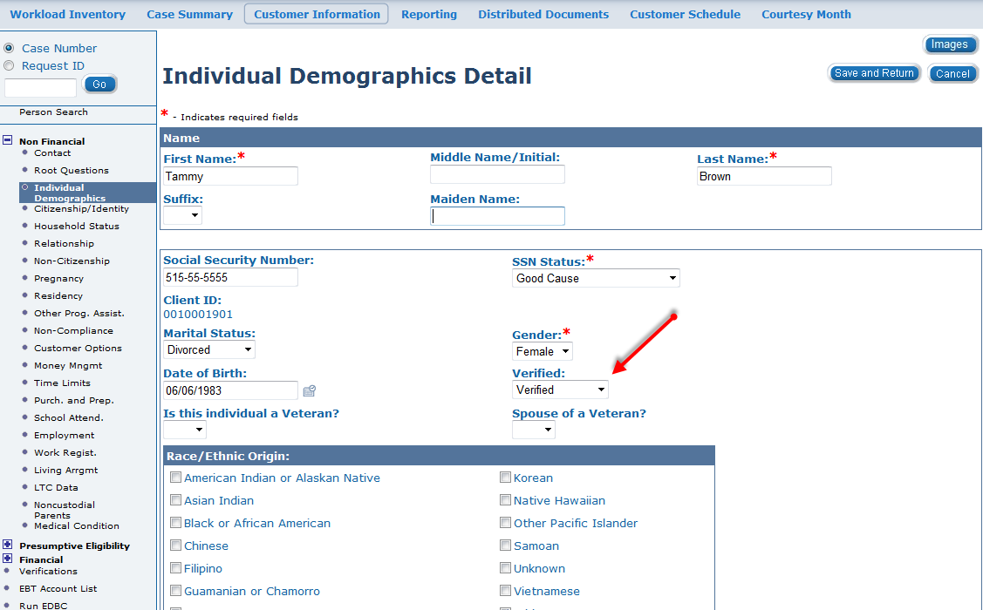
Medical Eligibility: Verifications
Lesson 1: Verification Fields > Shared and Unshared
Verifications that are shared between agencies for an individual have only one verification field.
Notes:
If there is a single verification field—and the user is not required to select a Program Type—this verification is a shared field.
Individual Demographics
Non-Citizenship
Employment Detail
Living Arrangement Detail
Medical Conditions Detail
Expense Amount Detail
Medicare Expense Detail
TPL/Medical Subrogation
TPL Other Health Insurance Detail

Slide 6
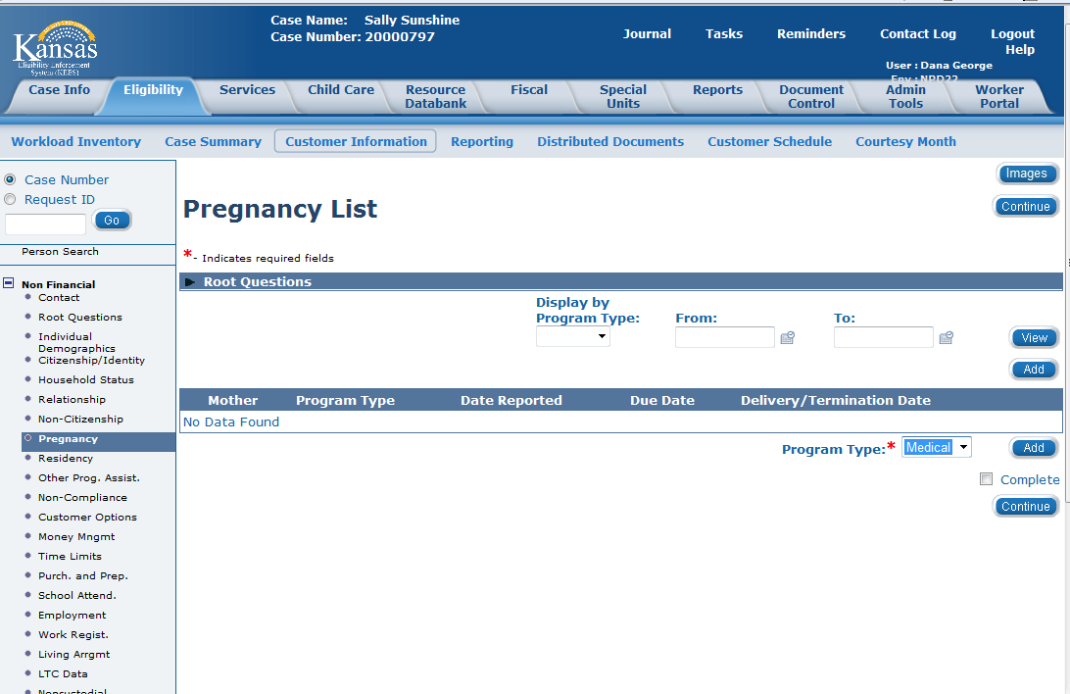
Medical Eligibility: Verifications
Lesson 1: Verification Fields > Shared and Unshared
Pregnancy, Resources, Income & Verifications allows the user to select Medical or Non-Medical in a Program Type drop-down before entering the data.

Slide 7
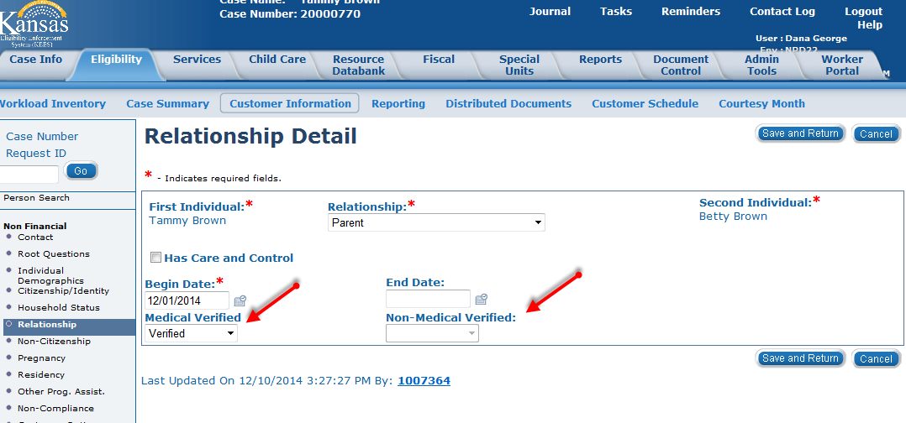
Medical Eligibility: Verifications
Lesson 1: Verification Fields > Shared and Unshared
Shared data on some pages
have a Medical verification field and a Non-Medical verification field on the page.
Notes:
Citizenship Detail
Relationship Detail
Residency Detail
Other Program Assistance Detail

Slide 8
Medical Eligibility: Verifications
Lesson 1: Verification Fields > Summary
Some verifications are field specific, other verifications are page specific.
It is important when marking information verified to pay close attention to what information is being verified.
This concludes the portion on the verification field in KEES.
Notes:
Next, we will discuss the drop-down options available in the verified field.

Slide 9
Medical Eligibility: Verifications
Agenda
Lesson 1: Verification Fields
Lesson 2: Verification Options
Lesson 3: How EDBC Rules use Verifications
Lesson 4: Verification List Page
Lesson 5: Request Verification Form
Lesson 6: Verification Received
Notes:
Verification Options

Slide 10
Medical Eligibility: Verifications
Lesson 2: Verification Options > Introduction
The drop-down options for the verified field can be selected by a worker or populated by interface data.
Let’s look at the verification options for KEES.
Notes:
Let’s look at the verification options for KEES.

Slide 11
Medical Eligibility: Verifications
Lesson 2: Verification Options > Drop-down Options
The dropdown values in most of the verification fields are:
Verified: This value is used when the user has some form of verification. Verification can be received from multiple sources.
Not Applicable: This value is used when the verification is not needed for the program.
Pending: This value is used when the verification needs to be requested.
Refused: This value is used when the consumer either refuses to provide or fails to provide the necessary information.
Notes:
A user may see Not Applicable already populated on a field depending on how the application was received (i.e. SSP). The user does NOT need to change these verification values. It will not affect the ability to run EDBC.
If the Refused value is selected and EDBC is run, this can close or deny a person’s assistance.

Slide 12
Medical Eligibility: Verifications
Lesson 2: Verification Options > SSN Status
SSN Status has its own special drop-down menu. The options for verifying SSN are:
HUB-SSA – set by interface
SSA-SVES – set by interface
Good Cause
SSN application filed at SSA
SSN Provided
No SSN Available
NOTE: This verification field is shared between agencies.
The first four verification values are considered Verified for medical programs.
The last two values are viewed as Pending and should populate a SSN request to the Verification List page.

Slide 13
Medical Eligibility: Verifications
Lesson 2: Verification Options > Sources
Verification fields can be completed by a worker or by an interface. Some Verified fields have a corresponding Source field
Some Auto-Populated Sources include:
HUB-SSA- Social Security
KDOL- KS Department of Labor
SDX-SSI
Notes:
The Source field is used to capture how/who verified the data. A batch can also bring in records: Sources can included: SVES & Bendex

Slide 14
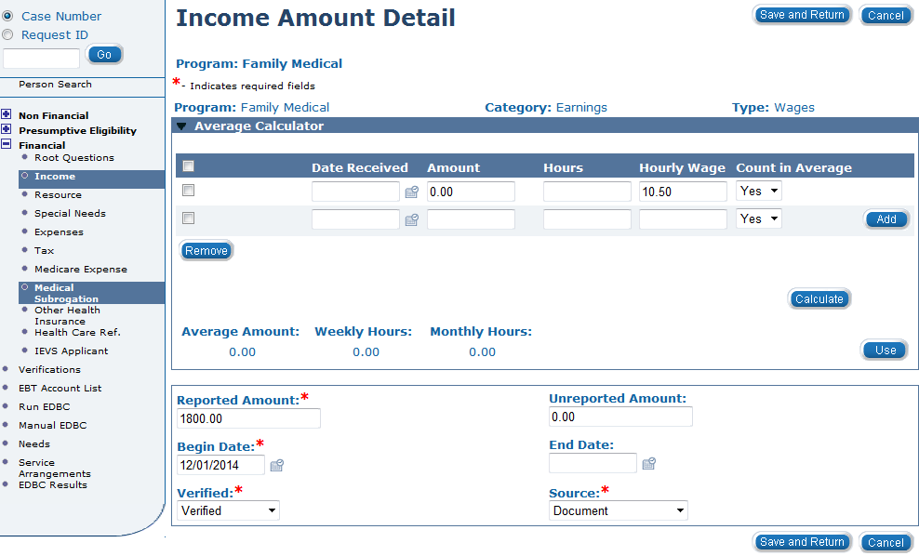
Medical Eligibility: Verifications
Lesson 2: Verification Options > Sources
Some User entered Sources include:
Consumer Statement
Collateral Contact
Document
Interface
Notes:
Some data obtained from interfaces will need to be entered by the user.

Slide 15
Medical Eligibility: Verifications
Lesson 2: Verification Options > Summary
Now that we have looked at the verification drop-down options for determining the status of entered data, let’s examine how EDBC rules use the verification data in determining eligibility.

Slide 16
Medical Eligibility: Verifications
Agenda
Lesson 1: Verification Fields
Lesson 2: Verification Options
Lesson 3: How EDBC Rules use Verifications
Lesson 4: Verification List Page
Lesson 5: Request Verification Form
Lesson 6: Verification Received

Slide 17
Medical Eligibility: Verifications
Lesson 3: How EDBC Rules use Verifications > Introduction
KEES has a rules engine that takes the data entered on various system pages, and then uses the information to determine eligibility for various medical programs.
Let’s go over how verification and source information interact with the rule base for EDBC.

Slide 18
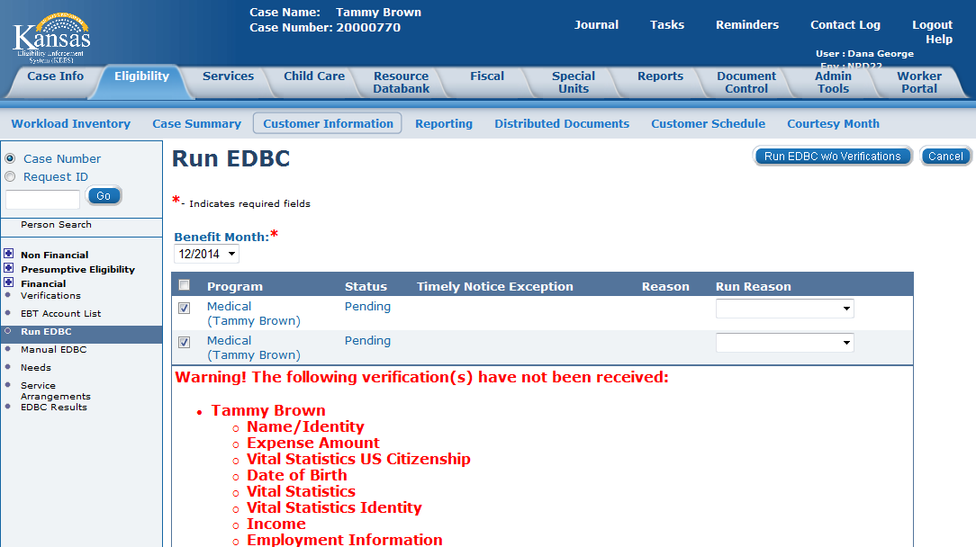
Medical Eligibility: Verifications
Lesson 3: How EDBC Rules use Verifications > EDBC Warnings
The EDBC rules are designed to “know” which verifications are required for program eligibility.
Any time a data element is Pending, the rules issue a warning to alert the user that data has not been verified.

Slide 19
Medical Eligibility: Verifications
Lesson 3: How EDBC Rules use Verifications > Summary
In this lesson we looked how the KEES rules engine uses the data entered on system pages to determine eligibility for various medical programs. If data is missing, pending or refused, a warning will display.

Slide 20
Medical Eligibility: Verifications
Agenda
Lesson 1: Verification Fields
Lesson 2: Verification Options
Lesson 3: How EDBC Rules use Verifications
Lesson 4: Verification List Page
Lesson 5: Request Verification Form
Lesson 6: Verification Received

Slide 21
Medical Eligibility: Verifications
Lesson 4: Verification List Page > Introduction
The Verification List page consolidates all the Pending verifications for a case.
To access the Verification List page, once in the context of a case, click the Eligibility tab on the Global Navigation, Customer Information on the Local Navigation and Verifications on the Task Navigation.
NOTE: All verifications on the list page are at the consumer level. If verification is needed for a consumer it will display on the Verification List page.
Notes:
The Verification list page in KEES houses all of the verifications in the data collection pages. This page can be sorted by the different verification statuses, but mostly workers will want to concentrate on which verifications are pending.
All verifications for each consumer show on the Verification List page—this is regardless of case or program. If a worker has requested a verification for a consumer for a food assistance case, the pending verification is listed on the page when the case is processed for family medical. This is very important to remember so that workers do not accidently delete verifications requested by another worker for either a different program or a different case. Verifications are sorted by Medical and Non Medical—so if you see a verification that is not for a program you are working, best practice is to leave the verification on the list page.
Similarly—if a consumer on a family medical case applies for an Elderly and Disabled program—verifications from both agencies can populate on the list page as Medical verifications. Remember, we do not want to delete a pending verification from the list page if it is being requested for another program, case, or agency.

Slide 22
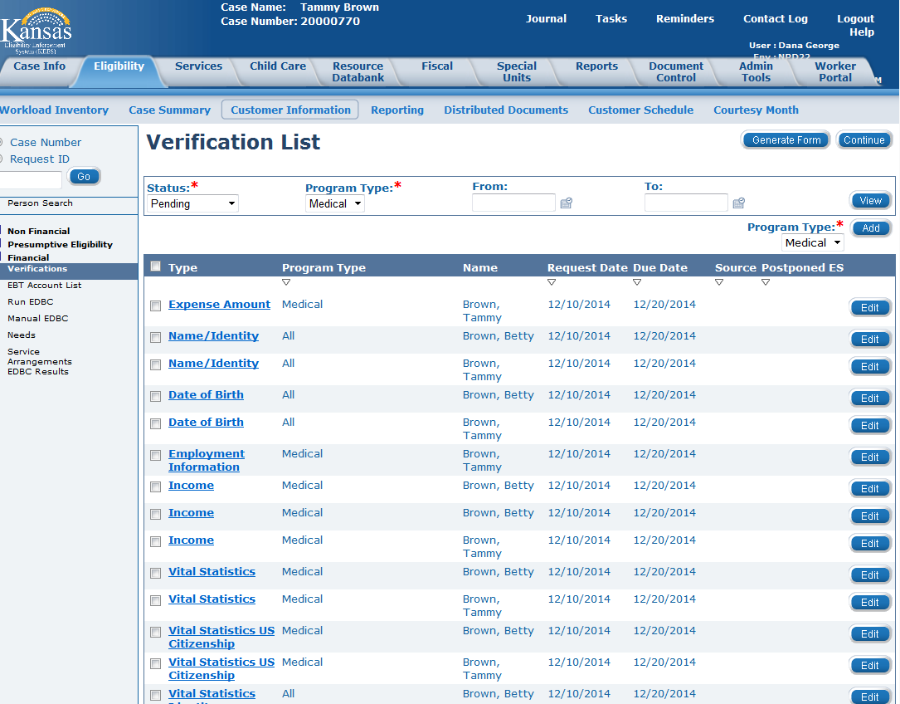
Medical Eligibility: Verifications
Lesson 4: Verification List Page > Overview
The Verification List page shows all verifications selected on the data collection pages. For a new application, the user can sort by Pending status to determine which verifications are still needed to process the case.
Notes:
The Verification List page shows all verifications selected on the data collection pages. This page is sortable by Status, Program Type (Medical, Non-Medical, All), Requested Date, and Due Date.
For determining if verifications are due, the user can search by From and To date.

Slide 23
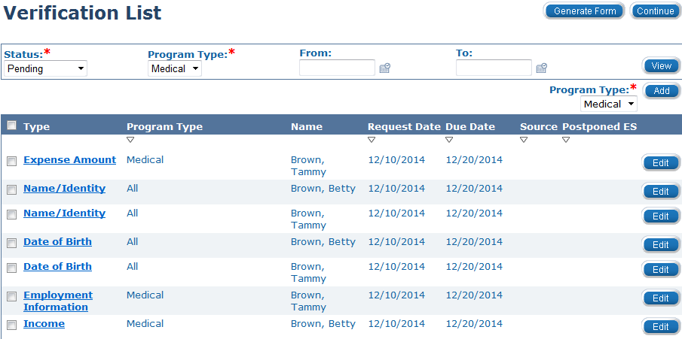
Medical Eligibility: Verifications
Lesson 4: Verification List Page > Sort and Edit Functions
Each of the verifications has a select checkbox to the left of the Type information. Each of the verifications also has an Edit button on the right side of the screen. The Edit button can be used to mark the information as verified or to extend the due date for the verification. Editing the due date on verifications needs to follow the appropriate business processes.
Notes:
Below the sort functions is the list of verifications. Verifications are displayed by Type, Program Type, consumer Name, Request Date, Due Date, and Postponed ES (this means postponed for expedited FA only).

Slide 24
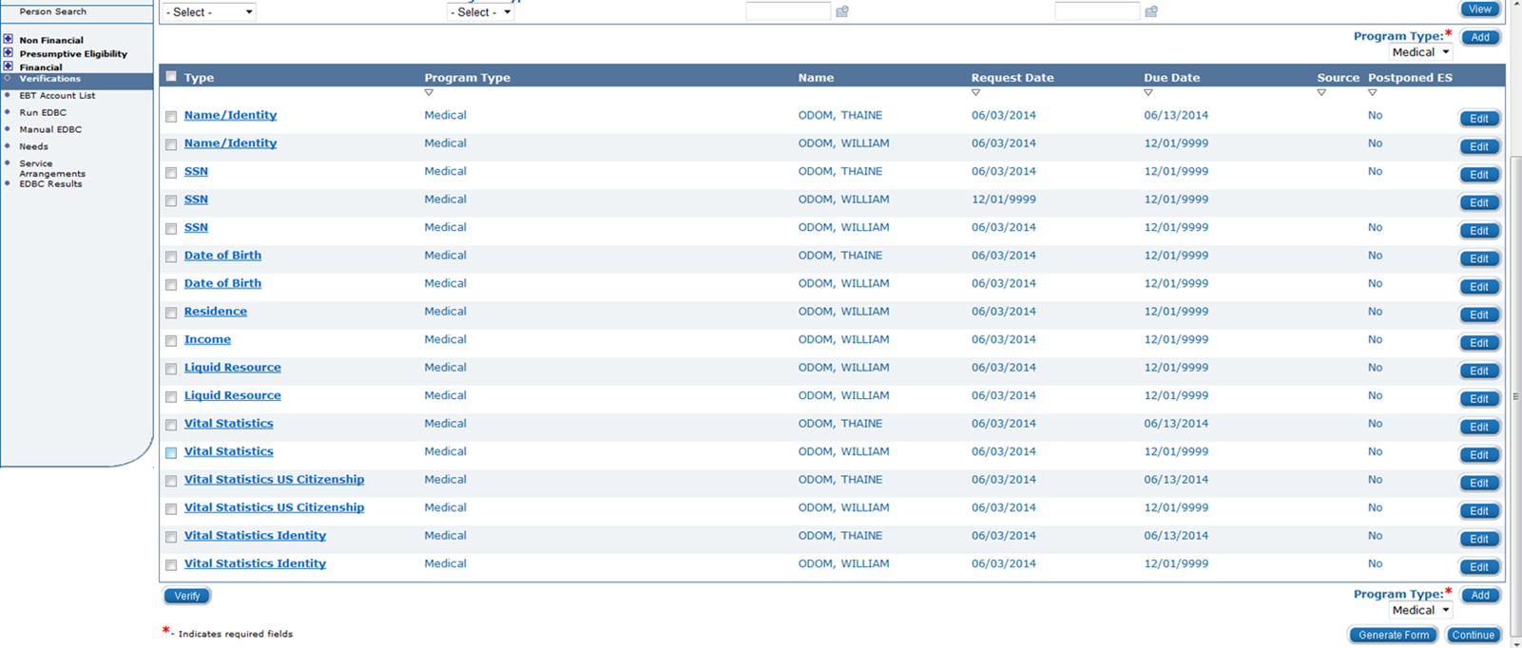
Medical Eligibility: Verifications
Lesson 4: Verification List Page > Verified
Below the displayed verifications is a Verify button. This button should not be used. The user will need to go to the appropriate page, record the correct value in the Verified drop-down, and record a Source when applicable.

Slide 25
Medical Eligibility: Verifications
Lesson 4: Verification List Page > Adding a Verification to Request
To the right of the Verify button is the place to add additional verifications that need to be requested. Select the Program Type (Medical) from the drop-down and click the Add button.
This action takes the user to the Verification Detail page.

Slide 26
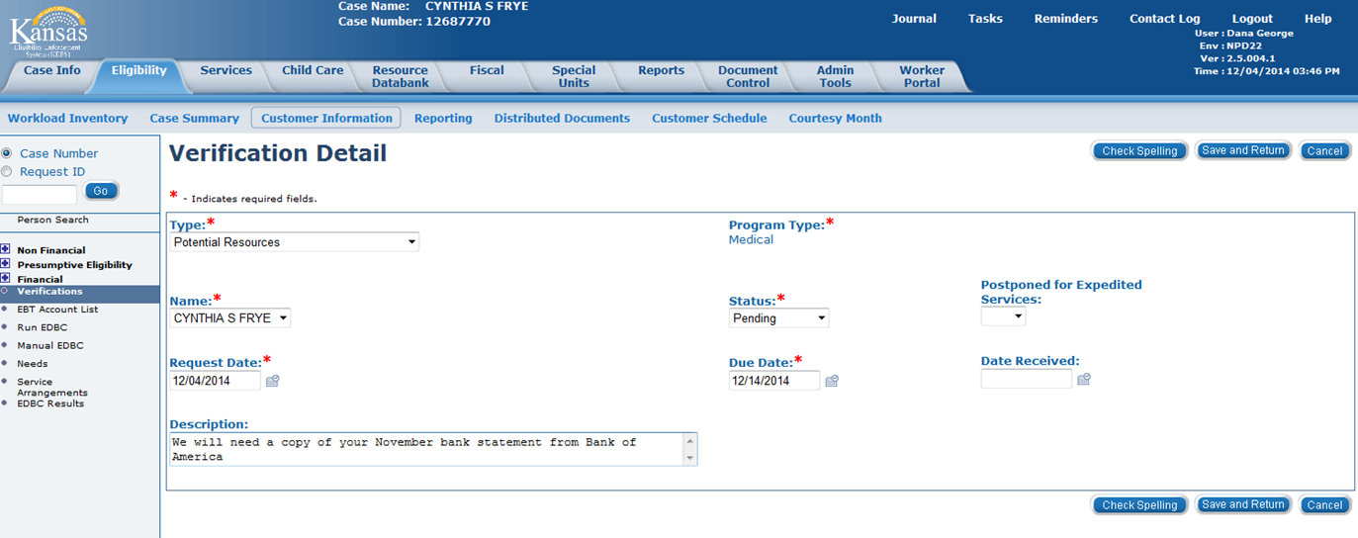
Medical Eligibility: Verifications
Lesson 4: Verification List Page > Verification Detail Page: Types
Once the verification Type is selected, select the Name of the individual from whom the verification is required using the Name drop-down box. Update the Status, Request Date and Due Date fields.
A user may also enter free form text in the Description box.
Notes:
The free form text will then display in Description field on the Verification Request form. This field is limited to 40 characters.

Slide 27
Medical Eligibility: Verifications
Lesson 4: Verification List Page > Verification Detail Page: Types
On the Verification Detail page, select the Type of verification. The options include:
Application Sig Page
Date of Birth
Date of Death
Dependent Care expense
Dependent Care Monthly Income
Employment Information
Expected Return Date
Expense
Expense Amount
Identity Verification
Income – drop down or type
Legal Guardianship
Medical Condition
Medicare Information
Motor Vehicle Registration
Name/Identity
Other Health Care Coverage
Other Program Assistance
Potential Resources
Pregnancy
Real Property Bona fide Effort
Relationship
Residence
Resource – drop down or type
Roomer/Boarder
School Attendance
School End Date
School Enrollment
School Expected Completion Date
Self-Employment Expense
Sponsored Non-Citizen
SSN
Termination Reason
Third Party Liability
Transferred Income
Transferred Property
U.S. Citizenship Verification
USCIS Document
Utility Expense
Work Program Orientation
Notes:
These are the types of verifications that can be selected on the Verification Detail page.

Slide 28
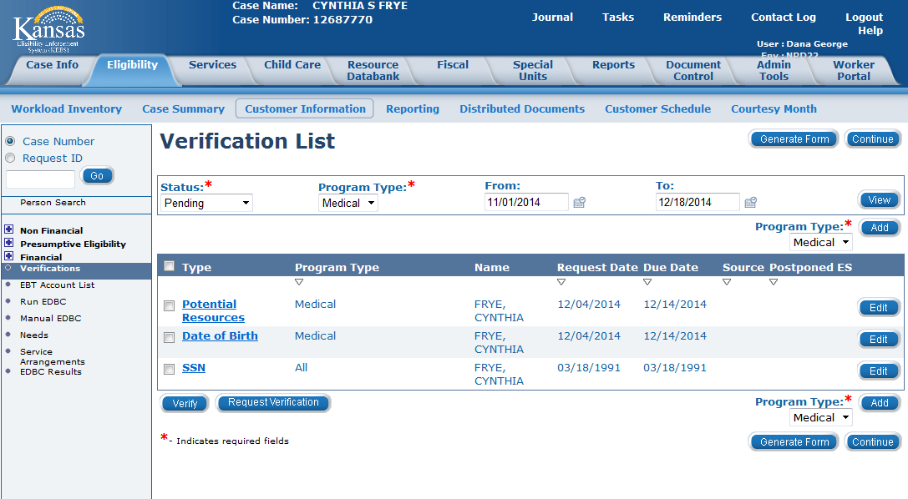
Medical Eligibility: Verifications
Lesson 4: Verification List Page > Updated Verification List
Once the verification detail is saved, the newly recorded verification will show on the Verification List page. The next button on the page is the Generate Form button.

Slide 29
Medical Eligibility: Verifications
Lesson 4: Verification List Page > Summary
This concludes the overview of the Verification List and Verification Detail pages.
The next lesson will discuss how this information is used to create a Request Verification Form.

Slide 30
Medical Eligibility: Verifications
Agenda
Lesson 1: Verification Fields
Lesson 2: Verification Options
Lesson 3: How EDBC Rules use Verifications
Lesson 4: Verification List Page
Lesson 5: Request Verification Form
Lesson 6: Verification Received

Slide 31
Medical Eligibility: Verifications
Lesson 5: Request Verification Form > Introduction
Once all needed verifications are captured on the Verification List page, a form needs to be generated to send to the consumer. A user can select to send a request for all verifications on the list page or to select which verifications are generated on the Verification Form (V001).
Let’s see how to generate the V001 form with selected verifications and with all verifications.

Slide 32
Medical Eligibility: Verifications
Lesson 5: Request Verification Form
A Verification Request (V001) Form is generated using the Generate Form button on the Verification List page.
The user can determine which verifications are requested by selecting them using the checkbox to the left of the verification listed.

Slide 33
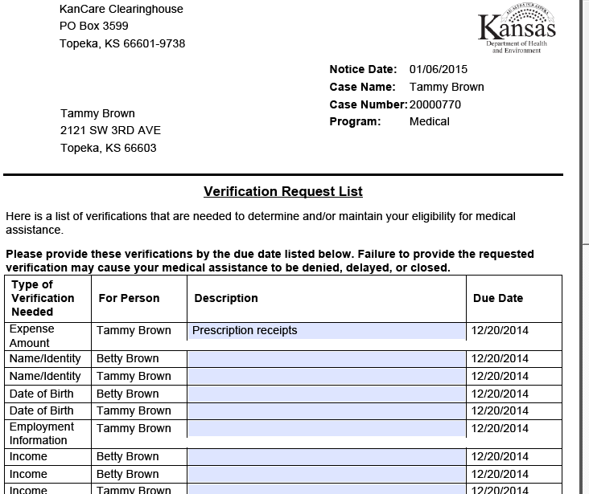
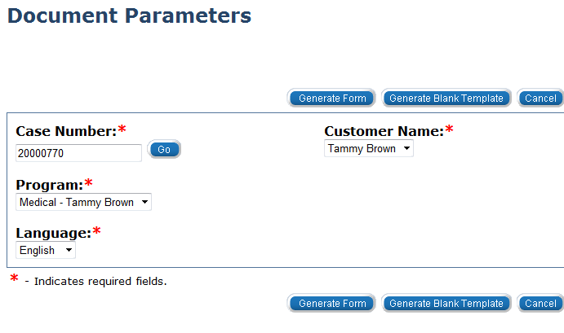
Medical Eligibility: Verifications
Lesson 5: Request Verification Form >
Notes:
After clicking the Generate Form button from the Verifications List page the Document Parameters screen will appear. The user will complete all mandatory fields & then select the Generate Form button. The Customer Name chosen will populate who the form is sent to. The form will appear with all the verifications being requested. If the user entered a description on any of the verifications on the Verification Detail page that information will populate in the Description field automatically.
The Description box is also an enterable data field that a user can populate directly on the form.

Slide 34
Medical Eligibility: Verifications
Lesson 5: Request Verification Form > Summary
In this lesson we looked at how a user would generate a form to request verifications from a consumer.
Now let’s look at how a user will update records once verifications have been received.

Slide 35
Medical Eligibility: Verifications
Agenda
Lesson 1: Verification Fields
Lesson 2: Verification Options
Lesson 3: How EDBC Rules use Verifications
Lesson 4: Verification List Page
Lesson 5: Request Verification Form
Lesson 6: Verification Received

Slide 36
Medical Eligibility: Verifications
Lesson 6: Verification Received > Introduction
When requested information is received from a consumer by mail or through the SSP a task is either created or updated. A user picks up the task via the queue and then must update the case appropriately.

Slide 37
Medical Eligibility: Verifications
Lesson 6: Verification Received > Processing Verifications Received [Data Collected in KEES]
When verification documents are received for information recorded in KEES, the user will:
Accept the Task
Review the documentation
Update the appropriate data collection pages (Citizenship, ID, Income, etc….) with the received information and update the verification field
If all documentation is received, run EDBC
This completes the process for verification captured on data collection pages.

Slide 38
Medical Eligibility: Verifications
Lesson 6: Verification Received > Processing Verifications Received [Data Collected in KEES]
It is important to verify information on the appropriate page when requested information is received.
Clicking the Verify button on the Verification List page updates the verified field on the corresponding data collection page; however this will NOT update any other data collection information.

Slide 39
Medical Eligibility: Verifications
Lesson 6: Verification Received > Processing Verifications Received [Data Not in KEES]
When verification documents are received for information which is not recorded in KEES, but is necessary for a determination the user will:
Accept the Task
Review the documentation
Update the Journal with the information
Access the Verification List page
Select the Edit button to the right of the verification received
Mark the information as verified including received date
If all documentation is complete, run EDBC
Notes:
Examples include:
Requesting a school record to confirm a child is in the home if conflicting information is received
Requesting proof of a 30 day hospital stay to know when to start a Division of Assets for a long term care case

Slide 40
Medical Eligibility: Verifications
Lesson 6: Verification Received > Verifications Not Received
Sometimes a consumer does not provide the requested verification.
The verification should not be left Pending, but the verification cannot be marked received.
The verification needs to be set as Refused on the data collection page containing that field or if there is no corresponding field on a data collection page that can be marked Refused, the worker will need to mark the record Refused on the Verification List page.
Marking the verification as Refused allows KEES to track that the request was made and the consumer did not comply.
Notes:
After a verification is marked Refused, a Non-Compliance record must be set so the case will be denied or closed.

Slide 41
Medical Eligibility: Verifications
Summary
Once information is received from the consumer, the document is imaged and a task is generated or updated.
When a user claims a task, it is up to the worker to examine the verifications received and determine if the information provided is satisfactory to determine eligibility. If the information meets the required criteria, the information can be marked as Verified.
If appropriate verification is not received, the verification needs to have the status updated as Refused to allow for the case to be denied for failure to provide and for KEES to track that the consumer did not comply with the request.

Slide 42
Medical Eligibility: Verifications
Wrap up
This concludes the lesson on Verifications.

