Slide 1
Medical Eligibility
Imaging for Workers
Notes:
Welcome participants to the training session.
Cover any housekeeping items such as:
The location of restrooms and breakrooms.
Ground rules for the training.
Instructor introductions.
Participant introductions.
Transition: Let’s talk about why we’re all here.

Slide 2
Imaging: DCF
Introduction
This course will provide DCF workers with an overview of the fundamentals of imaging, as well as explain the business process as it relates to the Imaging Solution for Case Workers.
After completing this course, you will be able to:
Identify ‘Hot’ or ‘Cold’ documents
Capture documents
Perform imaging duties (tasks) related to your role
Sort and View documents through the KEES Indexing eForm
Indexing to the person level
Troubleshoot Issues
Notes:
Transition: Let’s look at the lessons in this course.

Slide 3
Imaging: DCF
Agenda
Lesson 1: What is Imaging?
Lesson 2: Sorting Documents
Lesson 3: ImageNow Fundamentals
Lesson 4: Document Processing
Lesson 5: Document Management
Lesson 6: Troubleshooting

Slide 4
Imaging: DCF
Lesson 1: What is Imaging? > Introduction
This lesson will provide DCF workers with an overview of the KEES Imaging Solution and how it affects their day-to-day processes.
After completing this lesson, you will be able to:
Describe the benefits of the KEES Imaging Solution
Define, at high-level, some of the new terms

Slide 5
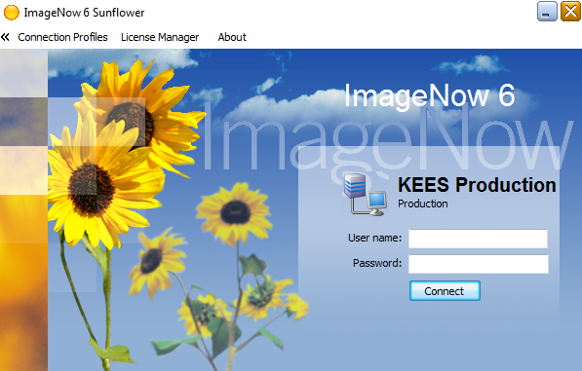
Imaging: DCF
Lesson 1: What is Imaging > Enterprise Content Management
ImageNow
  Ensures that all documents are secure, quickly retrievable, and associated to the files and application plans you want.
  Captures and manages data from:
    SSP
    Loose Mail
    Email, MS Office or PDF (electronic)
  Gives workers the ability to view, scan, process and search for documents.
Notes:
The KEES Imaging Solution is the Enterprise Content Management is also known as ECM. This system takes physical documents and stores them digital in an organized folders for DCF and Medical programs. This is also referred to as Imaging.
ImageNow is the software that will be utilized to capture and store electronic images.

Slide 6
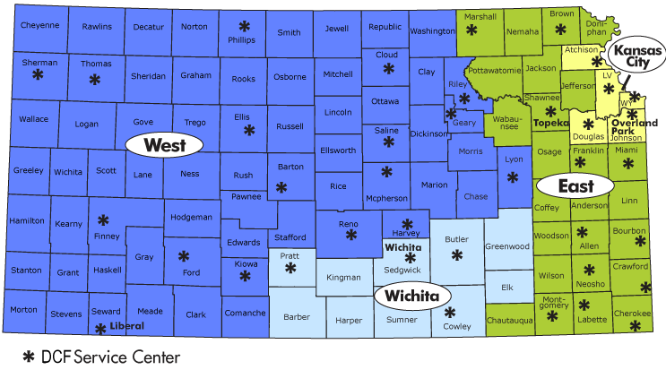
Imaging: DCF
Lesson 1: What Is Imaging? > Advantages
  Statewide Access
  Real-time access to Case File
  Streamlines ICTs
  Cross Program Case Files
Notes:
Ability to access an electronic file from anywhere in the state.
Gives workers electronic accessibility from their computer to documents previously kept in a paper file.
Ability to transfer a case and supporting documentation to another county electronically.
Allows ImageNow users to view case specific documents across programs within KEES. Example: Medical/EES documents will be viewable for all ImageNow Users.

Slide 7
Imaging: DCF
Lesson 1: What Is Imaging? > Imaging Processes
Imaging allows KEES users to scan documents and process images electronically. It gives users the ability to store and retrieve case and person related documents electronically and view the stored images online from within the KEES System.
The imaging process has three main functions.
Capture the document
Review the document
  Store
Retrieve the document
  Copy
  Re-Index

Slide 8
Imaging: DCF
Lesson 1: What Is Imaging? > Speaking the Language
Capture
  The ability to scan or import documents in to the Imaging Solution and store documents in the ImageNow
Review
  Reviewing image quality (readable) and assigning index values
  Ensuring the correct document was captured and indexed to the right case, no documents were missed, etc.
Retrieve
  The ability to search and retrieve a document inside of the KEES system
  The ability to search and retrieve a document inside of ImageNow Explorer
Notes:
Categorizing images enables them to be retrieved or found easier.
Use this opportunity to double check the capture step.

Slide 9
Imaging: DCF
Lesson 1: What Is Imaging? > Speaking the Language
Indexing
  Applying values (ex. Case Number, Case Name, Received date) to the document to categorize images in the appropriate folders/ cases
  Two Types of Indexing
    Automatically
    Manual
Indexing eForm
  Allows staff to enter additional indexing information, re-index documents and correct any indexing mistakes
  Can be used on documents associated to a KEES case number
  Index a document to a specific person
  Re-index the document to a different case number

Slide 10
Imaging: DCF
Lesson 1: What Is Imaging? > Speaking the Language
Documents that are received from the consumer will be imaged and indexed at either a person level or case level.
Person level
  The document follows the person from case to case
  This includes personal identifying documents
    Birth Certificate
    Driver’s License
    Social Security Card
Case level
  The documents doesn’t follow the person from case to case
  This includes general documents
    Landlord Letter
    Paycheck Stubs
Notes:
DCF’s expectation is to image documents to the person level whenever appropriate.

Slide 11
Imaging: DCF
Lesson 1: What Is Imaging? > Capture Profiles
Package Mode
  Allows an individual to scan several types of documents for the same case at one time.
  DCF will always be using this mode when capturing physical documents.
IN Printer
  Utilize the ImageNow virtual printer to capture electronic documents into ImageNow.
  Imports a document, from Microsoft Office or email, into ImageNow without printing and scanning first.

Slide 12
Imaging: DCF
Lesson 1: What Is Imaging? > Summary
In Lesson 1 we have looked at:
Benefits of the KEES Imaging Solution
High level definitions of some new terms

Slide 13
Imaging: DCF
Agenda
Lesson 1: What is Imaging?
Lesson 2: Sorting Documents
Lesson 3: ImageNow Fundamentals
Lesson 4: Document Processing
Lesson 5: Document Management
Lesson 6: Troubleshooting

Slide 14
Imaging: DCF
Lesson 2: Sorting Documents > Introduction
This lesson will provide DCF workers with the lobby and non-lobby processes. We will also define the steps required prior to the beginning of the imaging process.
After completing this lesson, you will learn:
Hot versus Cold document processing
Lobby process and cover sheet
Non-lobby process
Why we use the Unknown drawer

Slide 15
Imaging: DCF
Lesson 2: Sorting Documents > COLD Documents
What is COLD?
  Case Information that requires no further action
    For example, supporting documentation from a lobby interview where the worker processed the case, historical documents, and/or file only documentation.
  Documents must be imaged within 3-5 days of receipt
  All PPS documents will be imaged after a program has been processed.

Slide 16
Imaging: DCF
Lesson 2: Sorting Documents > HOT Documents
What is HOT?
  An application received through the lobby that does not have an eligibility determination made by the worker
  Documents to be routed to the Clearinghouse
  Unworked or unprocessed document(s)
    24 hour turnaround
    Must be imaged same day – no later than the next day
  Documents received via non-lobby
Notes:
Note: If documents are prioritized as hot for one agency on combination applications, they are prioritized as hot for both. Let’s look at an example.

Slide 17
Imaging: DCF
Lesson 2: Sorting Documents > HOT Documents
Example:
A consumer submits separate applications for medical and non-medical coverage through the lobby.
The medical application didn’t meet the Big 4 criteria so it is routed to the Clearinghouse (making the application a hot scan). A determination was made on the non-medical case.
Since part of the application is prioritized as hot, the whole application is prioritized as such.
HOT
Medical Application
Notes:
Supporting documentation must be included with both applications when a medical and non-medical application are received. Make a photo copy, include a set with each application, or keep the applications together and image the set of supporting documentation with each application.

Slide 18
Imaging: DCF
Lesson 2: Sorting Documents > Lobby Process
Claim client from the assigned BPM Lobby Tracker
Date Stamp the paper application
Register program if applicable to the appropriate KAECSES and/or KEES system
Follow the process management principles
Eligibility determination has been completed
Update the appropriate BPM Tracker with case status
Complete the coversheet for Imaging
Place documents in the basket (Cold or Hot)
Notes:
Remember:
Cold means that the case information that requires no further action. For example, supporting documentation from a lobby interview, historical documents, and/or file only documentation.
Hot means there is Unworked or unprocessed document(s) received. Must be imaged within 24 hours of receipt.
Note: If documents are prioritized as hot for one agency on combination applications, they are prioritized as hot for both.

Slide 19
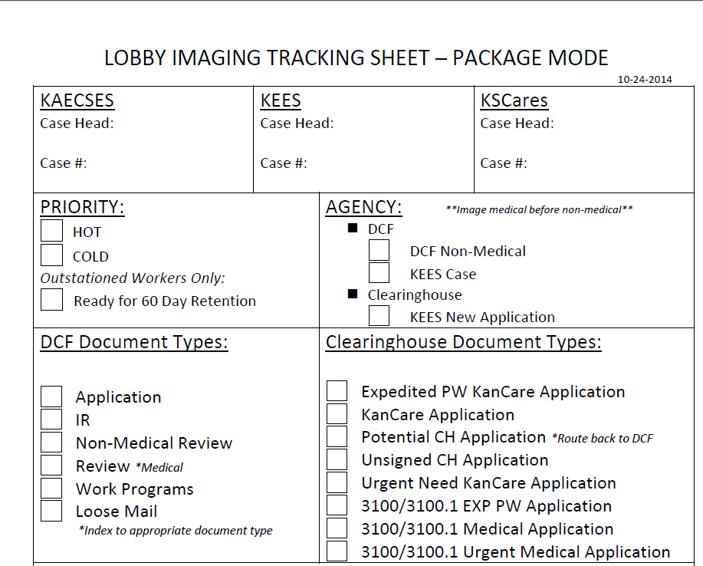
Imaging: DCF
Lesson 2: Sorting Documents > Lobby Process
Notes:
You would complete the appropriate sections based on your documents. It’s important to complete the Case Head and Case number so the Imager doesn’t have to re-investigate.
You will indicate the priority and identify which agency documents should be routed to.
Staff need to check the appropriate document type under DCF Document Types section.
If you have documents that are needing to be sent to the Clearinghouse, supporting documentation must be included with both applications when a medical and non-medical application are received. Make a photo copy, include a set with each application, or keep the applications together and the imager will image the set of supporting documentation with each application. If you create an individual set a cover sheet must be completed.
Potential CH Application doc type needs to be used if at least 1 person on a medical application meets the “Big 4” screening criteria. Urgent Need doc types are to be used for anyone needing immediate medical assistance.
Once you have completed the coversheet you will place all the documents into the appropriate basket.

Slide 20
Imaging: DCF
Lesson 2: Sorting Documents > Non-Lobby Process
Claim client from the assigned BPM Non-Lobby Tracker
Retrieve Document from ImageNow or within the KEES system
Follow the process management principles
Eligibility determination has been completed
Update the appropriate BPM Non-Lobby Tracker with case status

Slide 21
Imaging: DCF
Lesson 2: Sorting Documents > Returned Mail
Step 1
Support Staff will Date Stamp the Returned Envelope
Step 3
HSS will process the returned mail in either KAECSES or KEES
Step 4
Case Number and Case Head is written down on Returned Envelope
Step 5
Attach the Non-Lobby Imaging Tracking Sheet
Step 2
Batches it and Delivers to the Purple Area
Step 6
Documents are placed in the Cold Basket
Document Types
Returned mail-in state
Returned mail-out of state
Returned mail-no forwarding address
Returned mail-no forwarding address PR letter
Notes:
The mail room person/imager/HSA will date stamp the returned envelopes.
Then batches it with the other returned mail and delivers it to the purple area for processing.
The purple team will take the necessary action on the case in either KAECSES or KEES. Next the worker will provide the Case Number and Case Head on the returned envelope.
Then you will batch and complete the cover sheet indicate the application type (Medical or Non-Medical) and application plan. Then you will place the documents in the Cold basket for imaging.

Slide 22
Imaging: DCF
Lesson 2: Sorting Documents > Unknown Drawer
The UNKNOWN Drawer
DCF is going to allow Eligibility Workers to look in the drawer and re-index “unknown” documents as needed.
Workers will need to search with a location since the UNKNOWN drawer is Statewide.
Each office is to designate 1 person to manage and routinely clean-up the drawer as well.

Slide 23
Imaging: DCF
Lesson 2: Sorting Documents > Summary
In Lesson 2, you learned:
Hot versus Cold document processing
Lobby & Non-Lobby processes and cover sheet
Why we use the Unknown drawer

Slide 24
Imaging: DCF
Agenda
Lesson 1: What is Imaging?
Lesson 2: Sorting Documents
Lesson 3: ImageNow Fundamentals
Lesson 4: Document Processing
Lesson 5: Document Management
Lesson 6: Troubleshooting

Slide 25
Imaging: DCF
Lesson 3: ImageNow Fundamentals > Introduction
This lesson will provide DCF workers the basic ImageNow navigation.
After completing this lesson, you will learn:
How to sign-in to ImageNow
Toolbar functionality within ImageNow
Notes:
Now let’s look at ImageNow Processing by starting with basic ImageNow navigation.

Slide 26
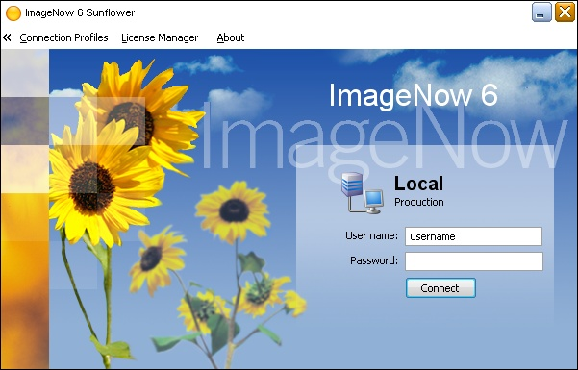


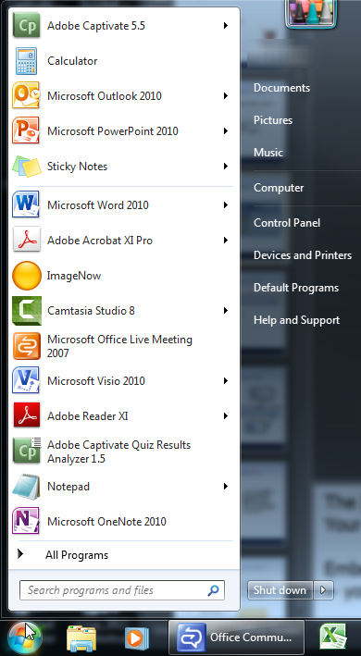
Imaging: DCF
Lesson 3: ImageNow Fundamentals > Icon and Login
Launch ImageNow
  To Log-In to ImageNow
  KEES Username
  Password
Notes:
Interactive Slide
The ImageNow Icon will appear in three different places.
Your desktop (click the mouse), in your tool bar (click the mouse), or on your menu.
(Click the mouse.)
You must be logged into both Image Now and KEES to use the capture functions and the ability to view images within the KEES system.
This password will be same for KEES system.

Slide 27
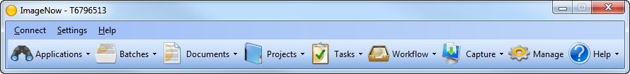
Imaging: DCF
Lesson 3: ImageNow Fundamentals > Toolbar
ImageNow Toolbar
  Easy Access to All ImageNow Software
  Configured to Users’ Business Role
Notes:
Once logged into ImageNow, the ImageNow Toolbar will grant access to the different components to which the user has access.
NOTE: Toolbar Buttons will be specific to the Users’ Role and Responsibilities
We’ll use the ImageNow Toolbar as the guide for walking through the rest of the ImageNow Training

Slide 28




Imaging: DCF
Lesson 3: ImageNow Fundamentals > Toolbar
Notes:
Interactive Slide
Click 1: Capture: To capture a document is to grab that document from its source and bring it into the ImageNow system. There are several ways to capture documents within ImageNow. DCF will only use Package Mode.
Click 2: Applications: Either LearnMode or Manual Application plan to set the indexing values based on KEES Case Summary, Non-Medical case information, or Unknown Drawer
Click 3: Documents: Easily Search and Access Documents within the ImageNow Repository
Manual Searching
Security: Only able to Search Documents within Specific Drawers
Private Filters – user specific
Click 4: Help: The Help button will allow users to search for generic, functionality based guidance when using ImageNow. The help button would remind a user how to search for a document or search to retrieve a document, but note that this help is not specific to the KEES solution.
“How to search for a document”
“How to link a document”
Transition: These Capture Profile settings allow a document to be quickly indexed at the time of capture.

Slide 29
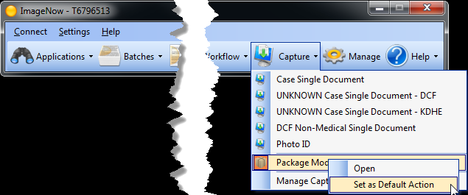
Imaging: DCF
Lesson 3: ImageNow Fundamentals > Settings
Setting “Default” Capture Profile & Application Plan
A user needs to set the appropriate default Capture Profile and Application Plan to help make document capture most efficient.
Notes:
Users can use other Capture Profile and Application Plan options by selecting the drop down arrow to the right of the Capture or the Applications buttons on the ImageNow Toolbar.
To use the default setting, return to selecting the Capture or Application button itself, instead of the drop down arrows to the right of the buttons. This would be a good way to capture a document using Single Mode when a user’s scan station is defaulted to Package Mode.
The following steps will set the default Capture mode:
Step 1. Click the Capture drop-down arrow
Step 2. Right click on the Package Mode
Step 3. Select Set as Default Action

Slide 30
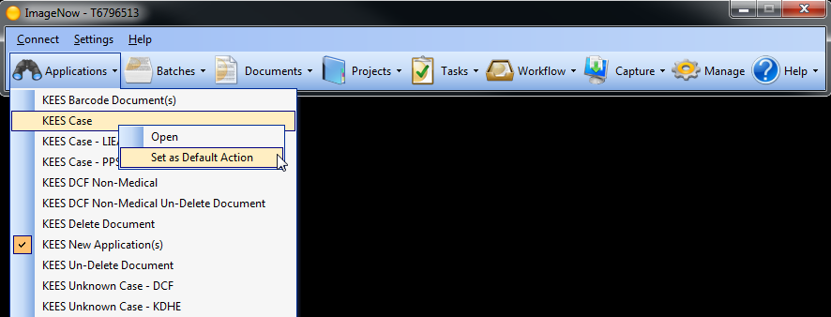
Imaging: DCF
Lesson 3: ImageNow Fundamentals> Settings
Notes:
Step 4: Click the Applications drop-down arrow
Step 5: Right Click the KEES Case Application Plan, and
Step 6: Select Set as Default Action

Slide 31
Imaging: DCF
Lesson 3: ImageNow Fundamentals > Summary
In Lesson 3, you learned:
Three different locations you can access the ImageNow icon
How to sign-in into ImageNow
Basic functionality of the Toolbar
How to set the appropriate default Capture Profile and Application Plan

Slide 32
Imaging: DCF
Agenda
Lesson 1: What is Imaging?
Lesson 2: Sorting Documents
Lesson 3: ImageNow Fundamentals
Lesson 4: Document Processing
Lesson 5: Document Management
Lesson 6: Troubleshooting

Slide 33
Imaging: DCF
Lesson 4: Document Processing > Introduction
This lessons provides users with a detailed understanding of key imaging and storing processes in relation to business practices found within the KEES Imaging System.
After completing this lesson, you will learn:
Imaging definitions
The two ways to capture
Capturing Applications and Supporting Documents
IN Printer process
Notes:
Now let’s look at ImageNow Processing by starting with basic ImageNow navigation.

Slide 34
Imaging: DCF
Lesson 4: Document Processing > Capturing a Document
There are two ways of capturing a document
  Physical Capturing
    Placing the physical documents in the scanner
  Electronic Capturing
    The ability for electronic documents to be captured via the Image Now (IN Printer)
Capture Profile is a reusable collection of settings that designates the matter of capture via a scanner or virtual printer.
  Different types of documents or business processes require slightly different settings
  Allows users to select the right settings for each specific need

Slide 35
Imaging: DCF
Lesson 4: Document Processing > Capture Profiles
Capture Profiles are classified by mode and type
  Mode
    Single Mode
    Package Mode
  Type
    Scanner Capture Profiles
    ImageNow Print Capture
ImageNow stores mapped information in a container called an Application Plans. These containers store information used to assign drawer, basket, document key, and custom property values to captured documents.
Therefore, the ImageNow Capture Profiles works together with the Application Plans to index documents.
Notes:
DCF will only use Package Mode. This mode is used in scanner capture profiles and is intended for walk-up or point-of-registration situations.

Slide 36
Imaging: DCF
Lesson 4: Document Processing > Capture Profiles
KEES Imaging Solution uses two types of Application Plans
  LearnMode
    Linked to pages within KEES to extract data for the designated index values.
  Manual
    Requires the user to populate the designated indexing value by typing each value.

Slide 37
Imaging: DCF
Lesson 4: Document Processing > Application Plans
LearnMode Application Plan
Application Plan | Description | Indexing Fields | When to use | Document Examples
KEES Case | To index documents to case information. The KEES Case Summary page will be leveraged to pull and index case level indexing values. | Case Number Case Name Received Date Unique ID Document Type | Use on any document tied to a medical program and the Case Number is known. | Registered E&D Applications E&D Reviews Returned Mail Medical Loose Mail
Notes:
Repeat: A LearnMode Application Plan is linked to pages within KEES to extract data for the designated index values.

Slide 38
Imaging: DCF
Lesson 4: Document Processing > Application Plans
LearnMode Application Plan
Application Plan | Description | Indexing Fields | When to use | Document Examples
KEES Case - PPS | To index PPS documents to case information. The KEES Case Summary page will be leveraged to pull and index case level indexing values. | Case Number Case Name Received Date Unique ID Document Type | Use on any document related to a PPS medical program and the Case Number is known. | PPS Forms PPS Legal Documents Personal Identifying Information
Notes:
Repeat: A LearnMode Application Plan is linked to pages within KEES to extract data for the designated index values.

Slide 39
Imaging: DCF
Lesson 4: Document Processing > Application Plans
Manual Application Plan
Application Plan | Description | Indexing Fields | When to use | Document Examples
KEES New Application(s) | To index new Applications that do not have a KEES Case number yet. | IN Application ID Last Name Received Date Batch ID Document Type | Always use the “KEES New Application(s)” application plan when imaging unregistered applications or when routing an application to the Clearinghouse. | Unregistered Medical or Non-Medical Applications. Applications routed to the Clearinghouse.
Notes:
A Manual Application Plan will require the user to populate the designated indexing value by typing each value.

Slide 40
Imaging: DCF
Lesson 4: Document Processing > Application Plans
Manual Application Plan
Application Plan | Description | Indexing Fields | When to use | Document Examples
KEES DCF Non-Medical | To index DCF Non Medical Document. | Case Number Case Name Received Date Unique ID Document Type | On any document tied to a non-medical program and the Case Number is known. | Registered Non-Medical Applications Non-Medical Review IR Returned Mail Non-Medical Loose Mail.
Notes:
A Manual Application Plan will require the user to populate the designated indexing value by typing each value.

Slide 41
Imaging: DCF
Lesson 4: Document Processing > Application Plans
Manual Application Plan
Application Plan | Description | Indexing Fields | When to use | Document Examples
KEES Unknown Case – DCF | To index DCF documents where KEES case number or KAECSES or KsCares Case number is unknown. | First Name Last Name SSN Received Date Fax Number/Email Address Document Type | Used when a document is received at a DCF Office and cannot be tied to a person and or Case. | Any document
Notes:
Repeat: A Manual Application Plan will require the user to populate the designated indexing value by typing each value.

Slide 42
Imaging: DCF
Lesson 4: Document Processing > Application Plans
Manual Application Plan
Application Plan | Description | Indexing Fields | When to use | Document Examples
KEES Barcode Document(s) | To index KEES generated barcode documents (i.e. documents created with a KEES generated barcode that were been delivered to designated consumers and since returned to the state). | Document Type | Any document with a KEES Generated Barcode. | Medical Review
Notes:
Repeat: A Manual Application Plan will require the user to populate the designated indexing value by typing each value.

Slide 43
Imaging: DCF
Lesson 4: Document Processing > IN Printer
IN Printer | Definition
IN Printer – Case | Documents that have a Case Number in KEES.
IN Printer – Case No Task | Documents that that have a Case Number in KEES. “No Task” will indicate that KEES will not trigger a task to be created for a user upon printing the document.
IN Printer – PPS Case | PPS related documents that have a Case Number in KEES.
IN Printer – Unknown Case – DCF | DCF related documents that don’t have a Case Number in KEES.
IN Printer – Unknown Case – KDHE | KDHE related documents that don’t have a Case Number in KEES.
IN Printer – DCF Non-Medical | Non-medical related documents that are non-medical related documents and have a separate DCF managed Case Number.
IN Printer – UNKNOWN Case – LIEAP | LIEAP related documents that don’t have a Case Number in KEES.

Slide 44
Imaging: DCF
Lesson 4: Document Processing > Using the IN Printer
Capture a Document using the ImageNow Printer
As a worker you may be receiving emails that need to be saved to a KEES case. To do this, use the ImageNow IN Printer to capture the page and associate it to the designated case.
You must be logged into KEES system and the ImageNow before you begin these steps.
Notes:
Users must start a new instance of Internet Explorer, and not simply utilize a new tab in their current Internet Explorer session.

Slide 45
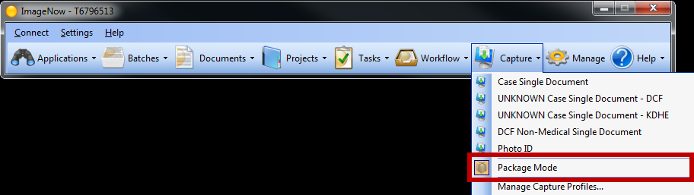
Imaging: DCF
Lesson 4: Document Processing > Capture Profiles
Check your Capture Profile to verify that it is set to Package Mode.

Slide 46
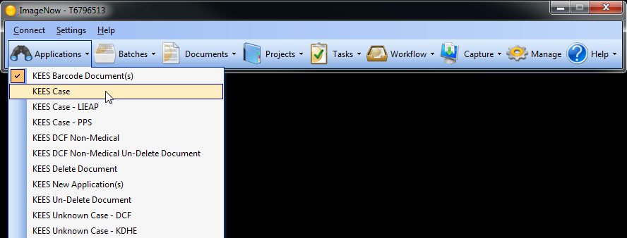
Imaging: DCF
Lesson 4: Document Processing > Capture Profiles
Next, you should make sure your Applications Plan reflects KEES Case for this process.

Slide 47
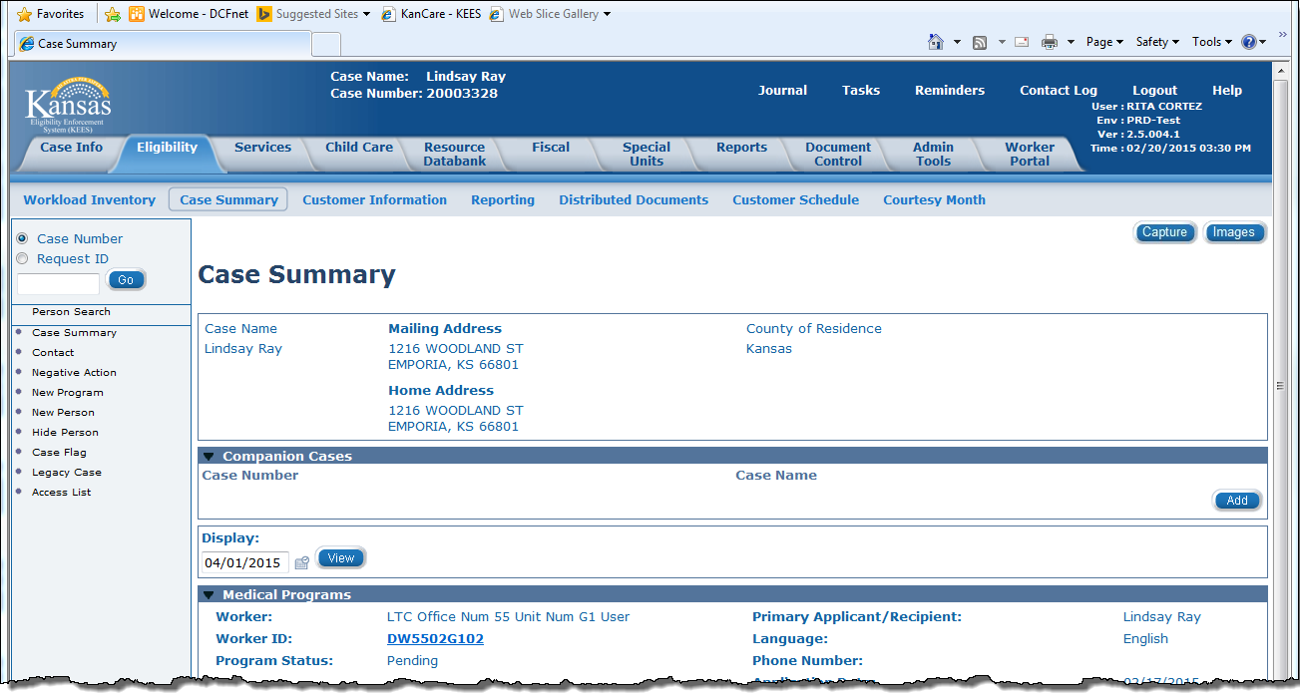
Imaging: DCF
Lesson 4: Document Processing > Capture Profiles
Next navigate to the appropriate case on the KEES Case Summary Page

Slide 48
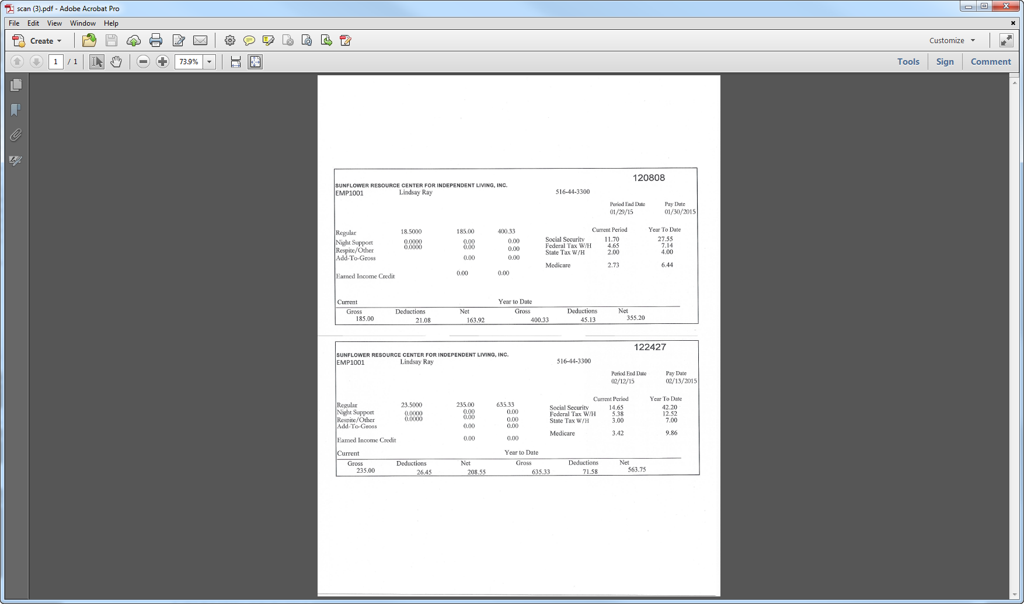
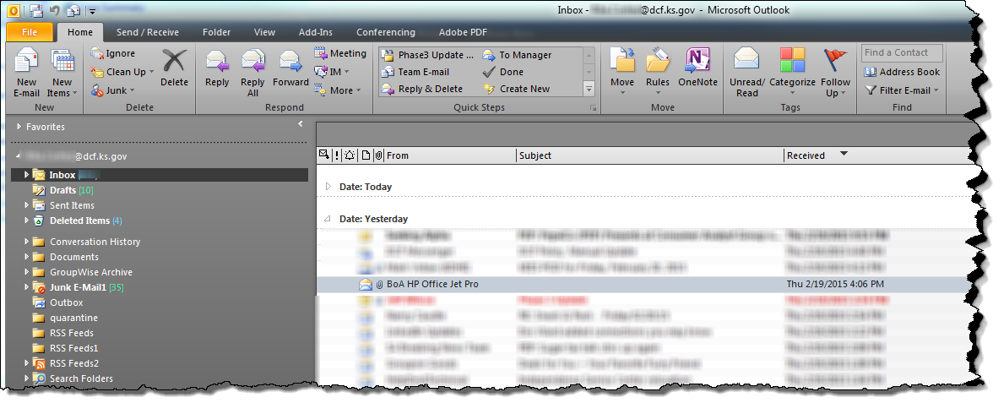
Imaging: DCF
Lesson 4: Document Processing > Capture Profiles
Select your document from your inbox and open the document.
Notes:
Interactive Slide

Slide 49
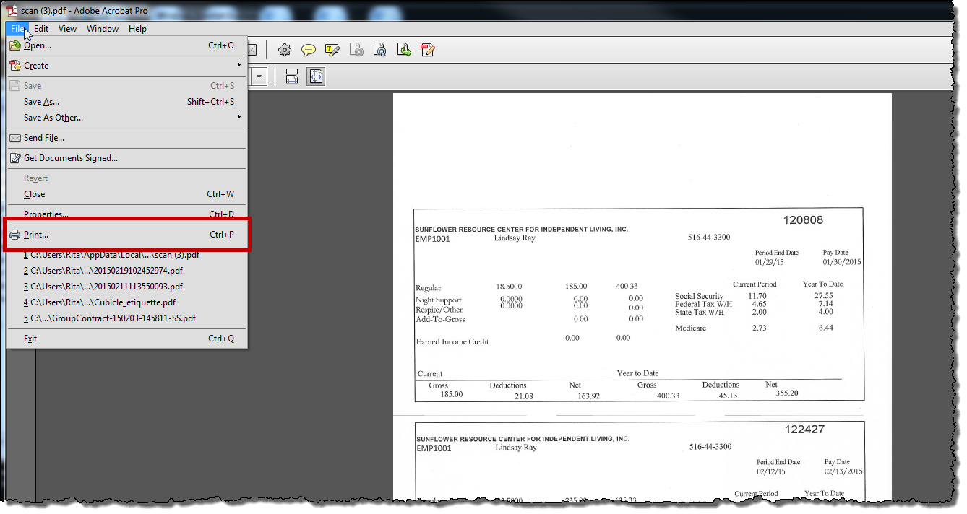
Imaging: DCF
Lesson 4: Document Processing > Capture Profiles
Select File then Print.

Slide 50
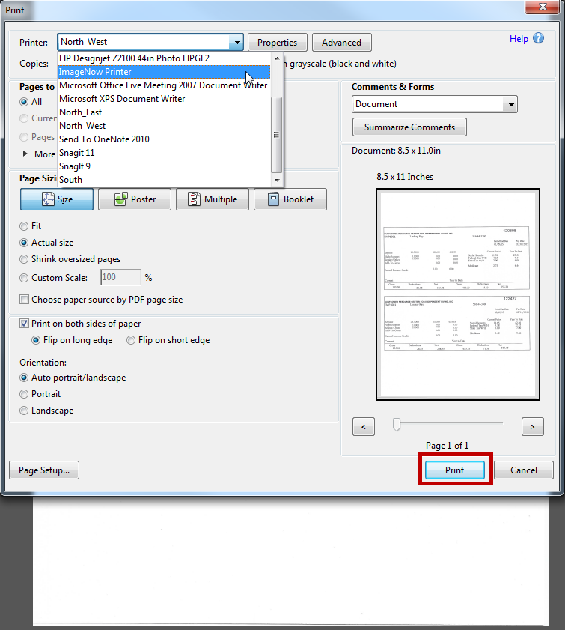
Imaging: DCF
Lesson 4: Document Processing > Capture Profiles
Select ImageNow Printer from the Printer location. Then click on the Print button.

Slide 51
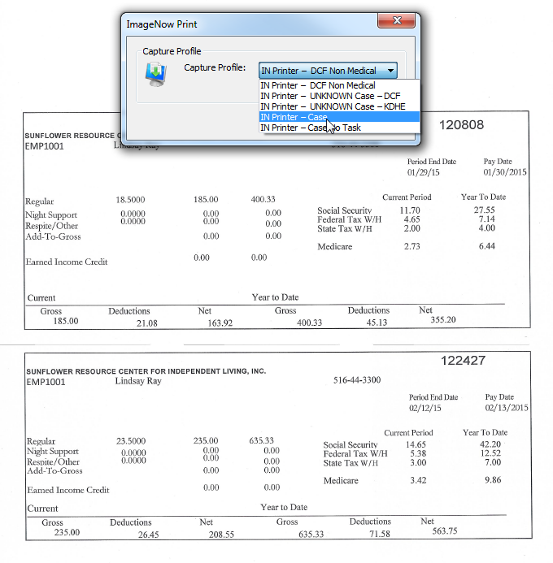
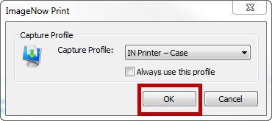
Imaging: DCF
Lesson 4: Document Processing > Capture Profiles
The ImageNow Print box will appear. Select IN Printer-Case from the Capture Profile drop-down. Then click on ‘Ok’.
Notes:
Interactive Slide
**User can select the “Always use this profile” checkbox to avoid this dialog box in future.

Slide 52
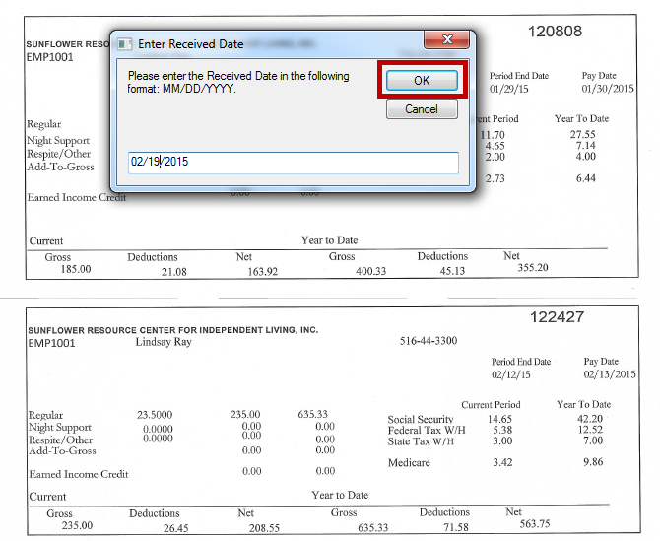
Imaging: DCF
Lesson 4: Document Processing > Capture Profiles
The Enter Received Date window will appear. Enter the received date if it’s different and OK.

Slide 53
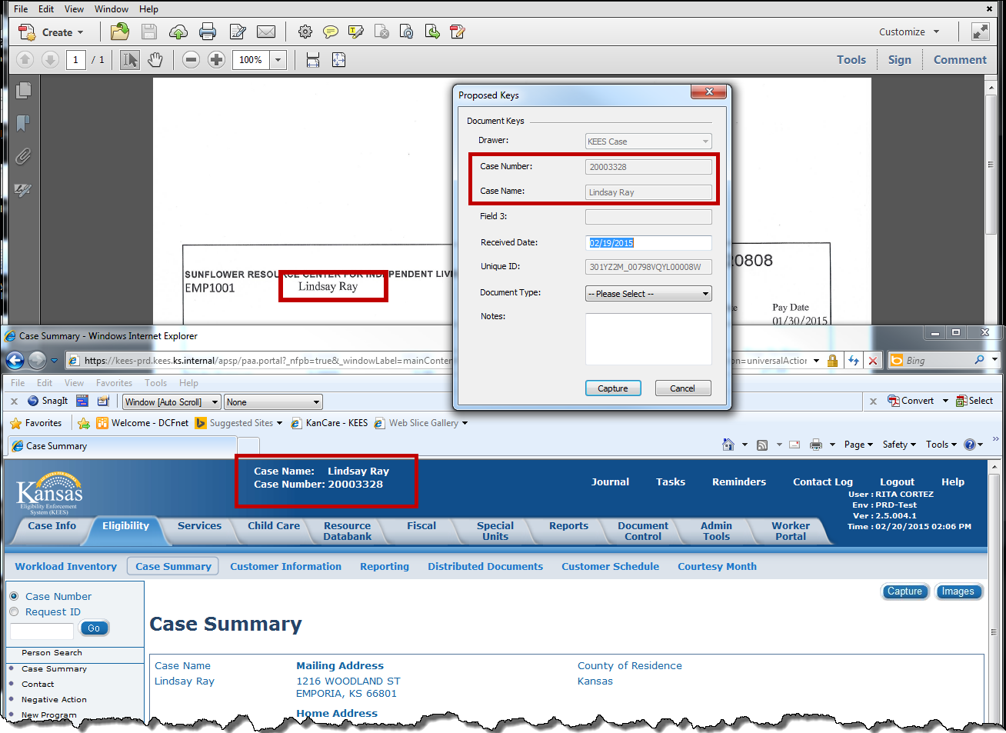
Imaging: DCF
Lesson 4: Document Processing > Capture Profiles
The Proposed Keys window will appear.
You will validate the Case Number and Case Name from the KEES Case Summary page.

Slide 54
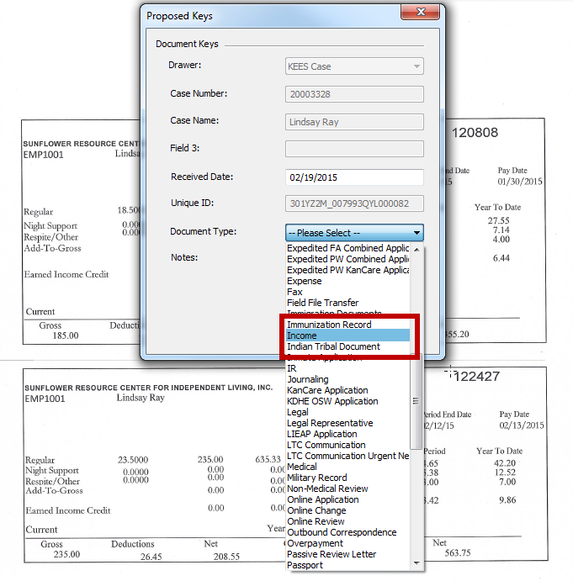
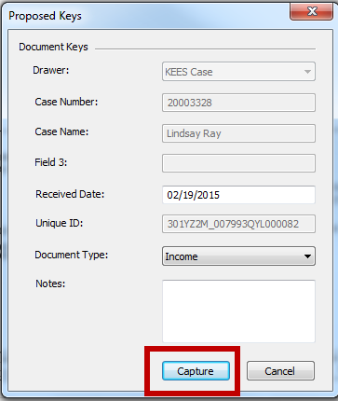
Imaging: DCF
Lesson 4: Document Processing > Capture Profiles
Then you will select a document type and click the Capture button.
Notes:
Interactive Slide

Slide 55
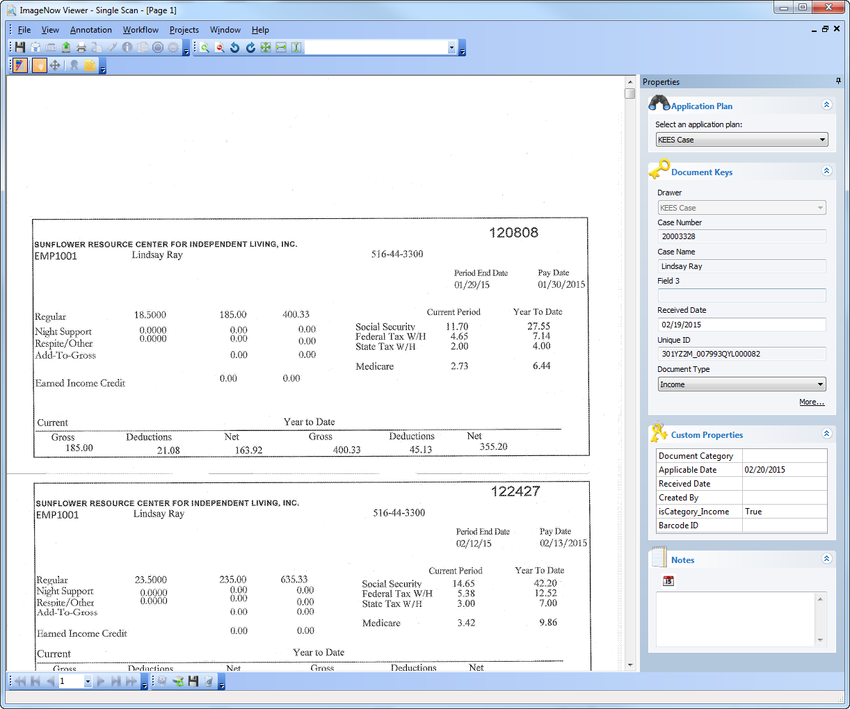
Imaging: DCF
Lesson 4: Document Processing > Capture Profiles
The ImageNow Viewer window will appear with your attachment showing.
Notes:
Review your document for readability.

Slide 56
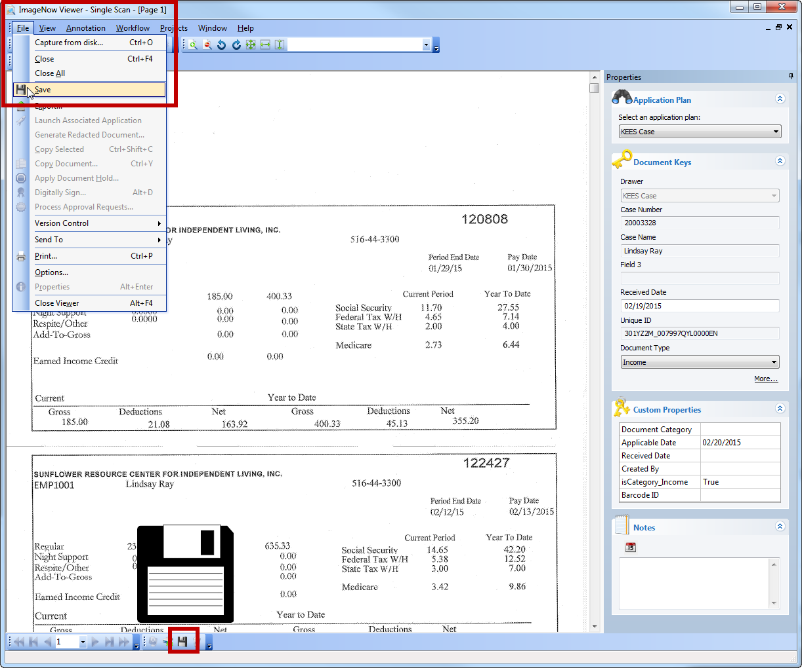
Imaging: DCF
Lesson 4: Document Processing > Capture Profiles
Click the “Submit” button. The ImageNow Viewer will close and the document will be indexed to the appropriate case number.
Notes:
There are two ways you can “Submit” the document.

Slide 57
Imaging: DCF
Lesson 4: Document Management > Summary
In Lesson 4, you learned:
Imaging processes and definitions
Two ways to capture documents
DCF capture profiles to be used for Phase 2
The steps used for IN Printer

Slide 58
Imaging: DCF
Agenda
Lesson 1: What is Imaging?
Lesson 2: Sorting Documents
Lesson 3: ImageNow Fundamentals
Lesson 4: Document Processing
Lesson 5: Document Management
Lesson 6: Troubleshooting

Slide 59
Imaging: DCF
Lesson 5: Document Management > Introduction
This lesson will walk through the process of retrieving a Document. After which, we will look at splitting and copying documents as well as indexing at the Person Level.
After completing this lesson, you be able to:
Retrieve a document
Split and copy a document
Index a document to the Person Level
Re-Index a DCF Non-Medical document to the correct case and document type
Notes:
Now let’s look at how to retrieve those documents.

Slide 60
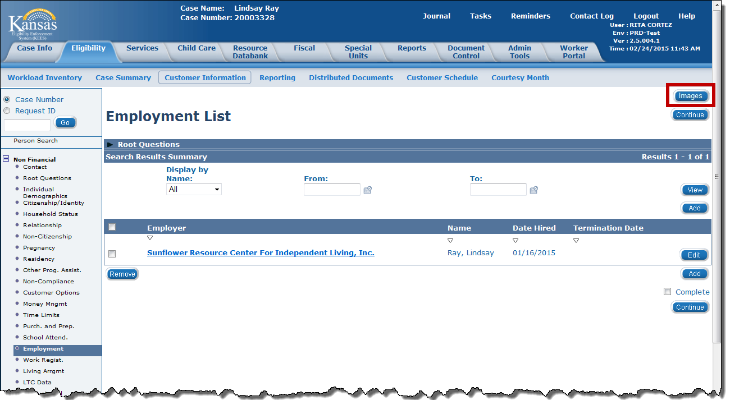
Imaging: DCF
Lesson 5: Document Management > Retrieval in KEES
Document Retrieval
  The ImageNow Solution utilizes the index values associated to the image to retrieve the correct document(s)
  Two Ways to Retrieve documents
    By selecting the Images button on the certain KEES pages
    By using the ImageNow Explorer
Notes:
Images Button in KEES are located on relevant KEES pages and will retrieve documents related to that page. For example: The income page will only retrieve documents related to income like pay stubs, tax forms, etc. This is controlled through the document type. Some document types may be visible from multiple KEES pages. We will walk through this process.

Slide 61
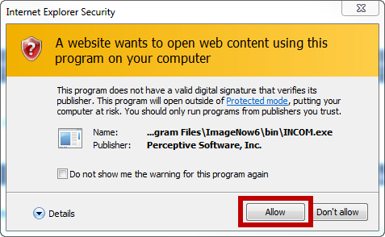
Imaging: DCF
Lesson 5: Document Management > Retrieval in KEES
Once you click on the Images Button in KEES, the following pop-up window may appear.
Notes:
We will select the “Allow” button.”

Slide 62
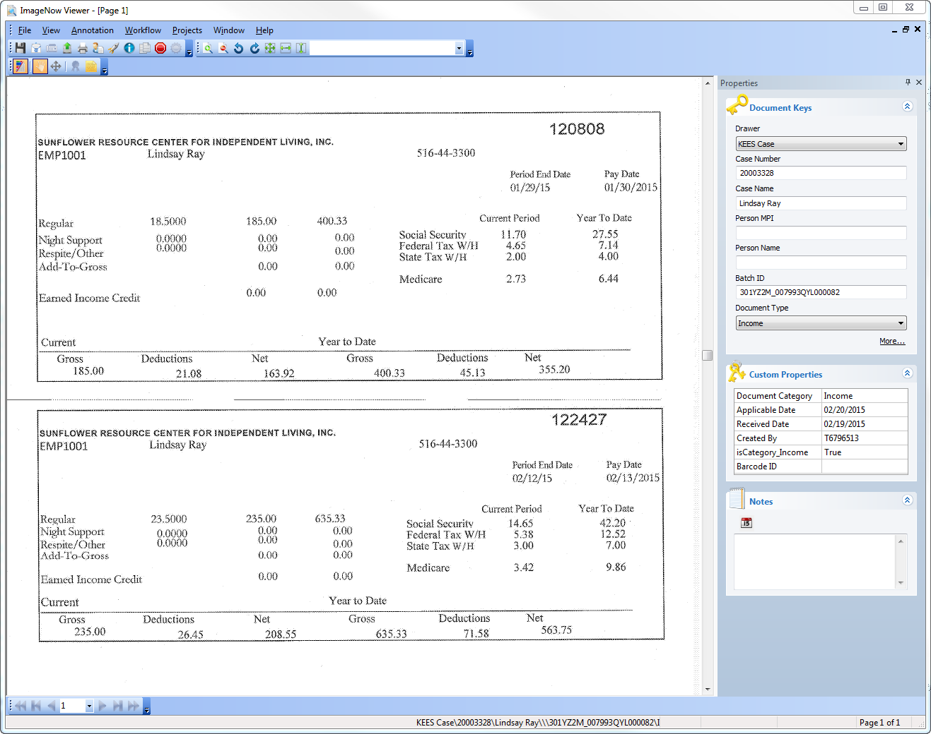
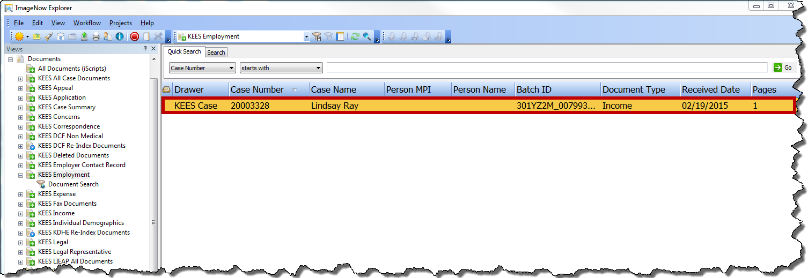
Imaging: DCF
Lesson 5: Document Management > Retrieval in KEES
The ImageNow Explorer window will display all images associated to that KEES page. You will double click on your image you want to appear. The ImageNow Viewer window will display your image for viewing.
Notes:
Interactive Slide

Slide 63
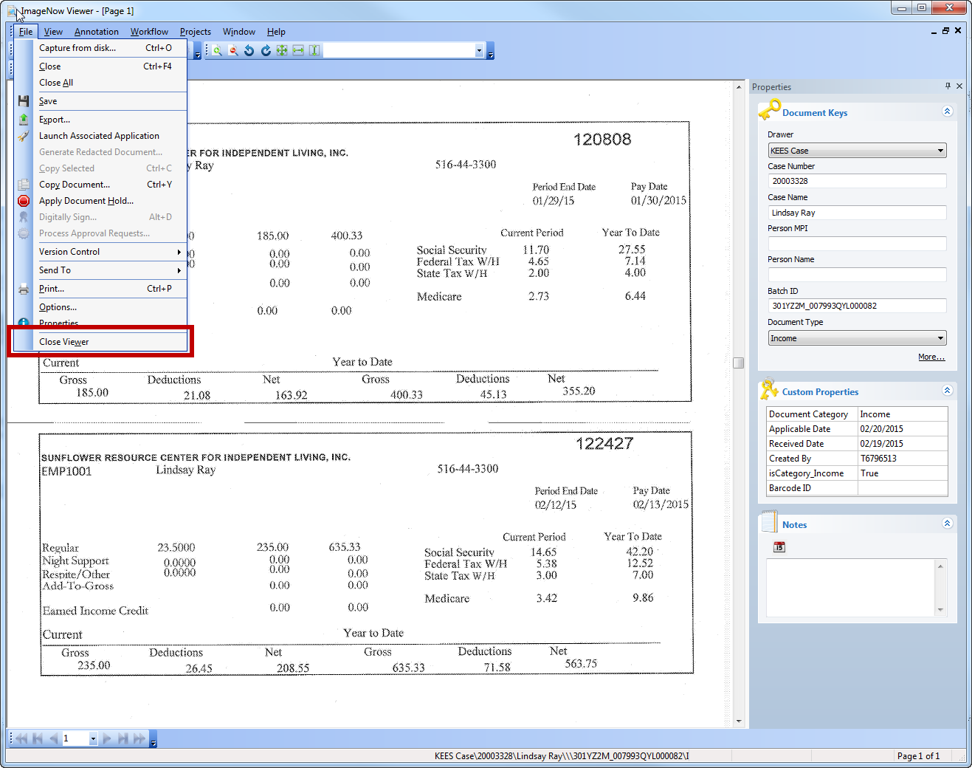
Imaging: DCF
Lesson 5: Document Management > Retrieval in KEES
Once you are done viewing the document, you can close the windows.

Slide 64
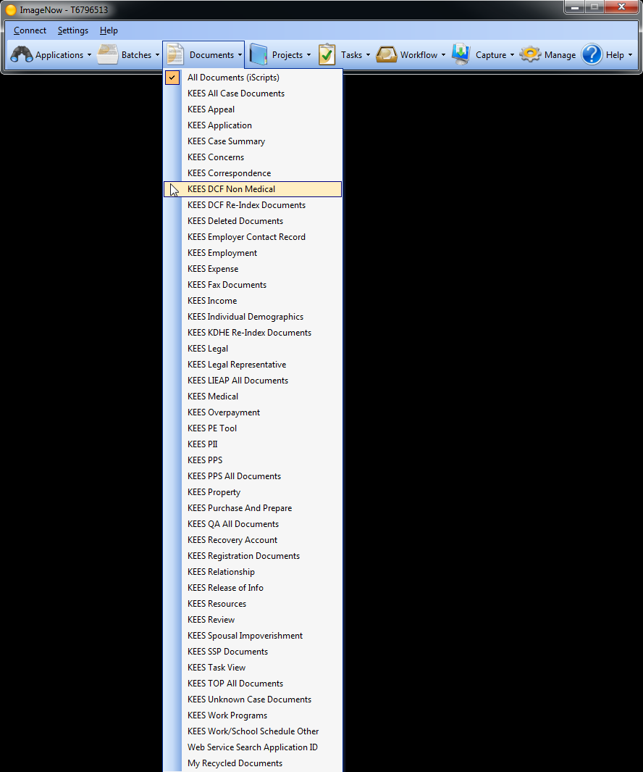
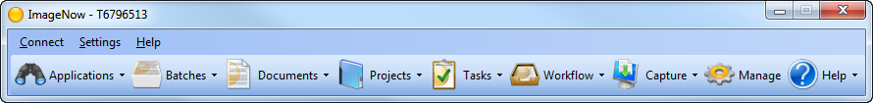
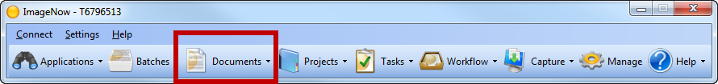
Imaging: DCF
Lesson 5: Document Management > Retrieval in ImageNow
STEP 2. ImageNow Toolbar will be displayed.
Notes:
Interactive Slide
There will be times when you will need to retrieve documents that are not associated to a KEES case. For example your non-medical applications, documents for Work Programs and unknown documents. Let’s see what steps are involved with this process.
Step 1. Log on to ImageNow.
Step 2. ImageNow Toolbar will be displayed. Navigate to the Document View drop-down on the ImageNow Toolbar and click on KEES DCF Non-Medical Documents as the desired Documents View filter.

Slide 65
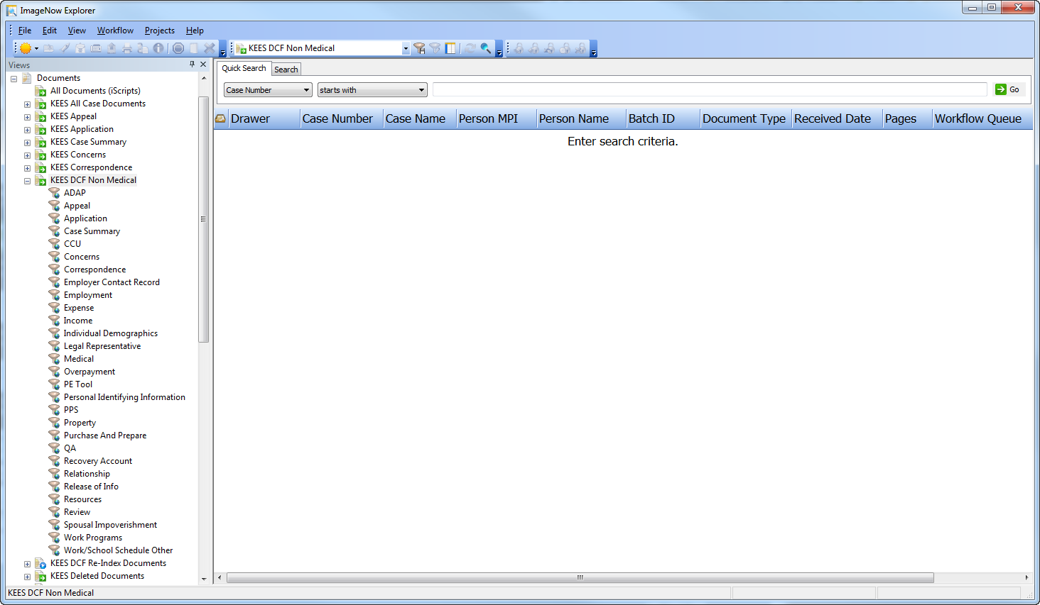
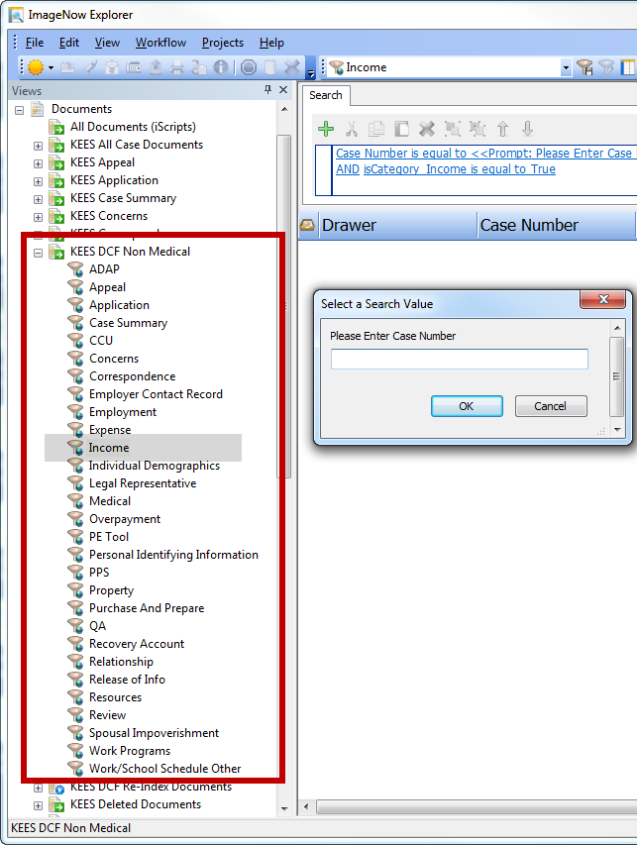
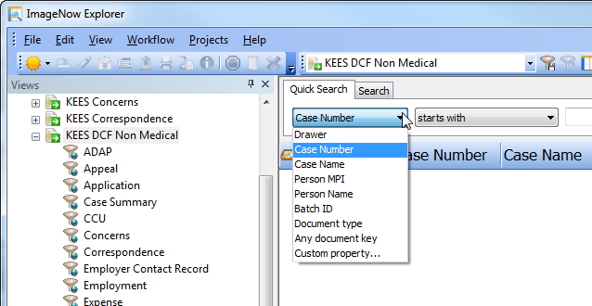
Imaging: DCF
Lesson 5: Document Management > Retrieval in ImageNow
Notes:
Interactive Slide
Step 3. The ImageNow Explorer will open.
Step 4. You can do a quick search by using the drop-down list or (Click the mouse) by using filters under the document type.

Slide 66
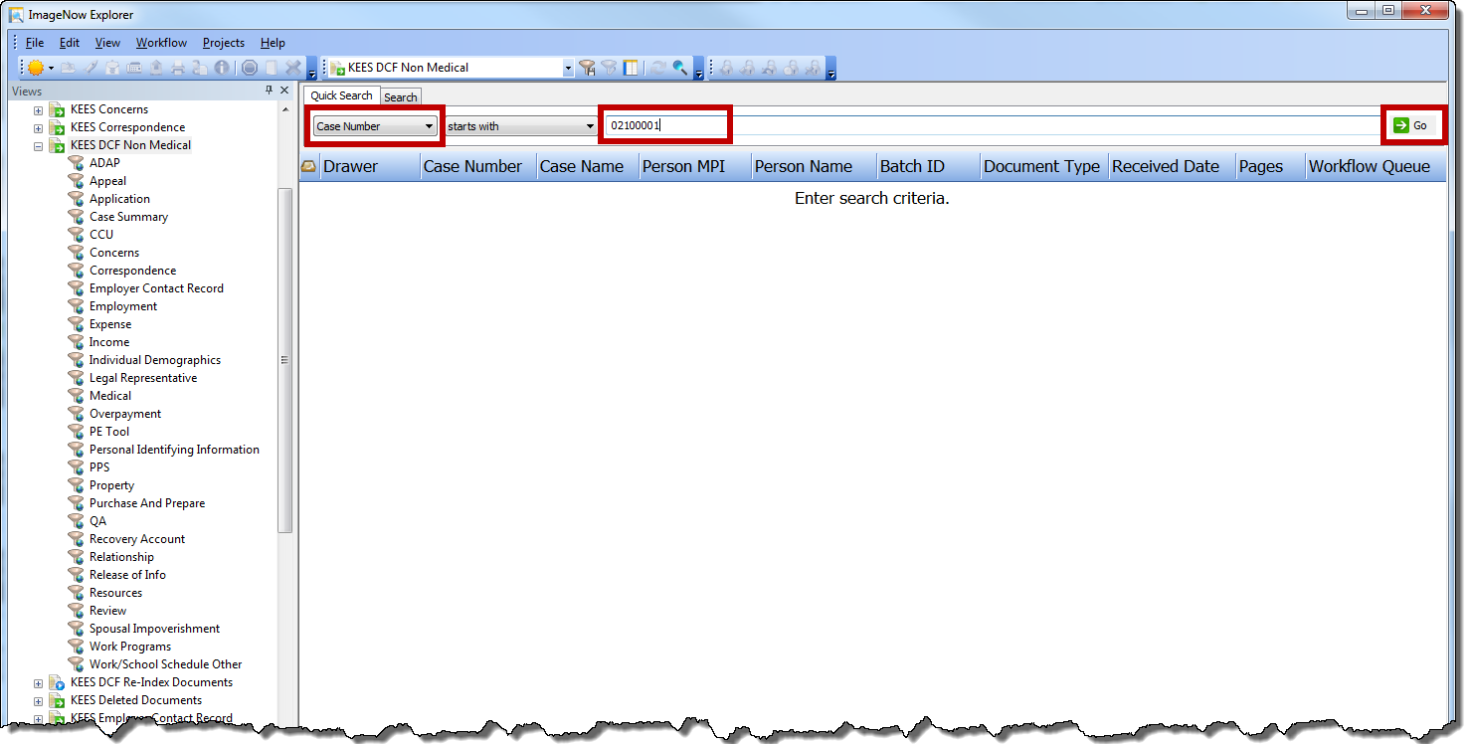
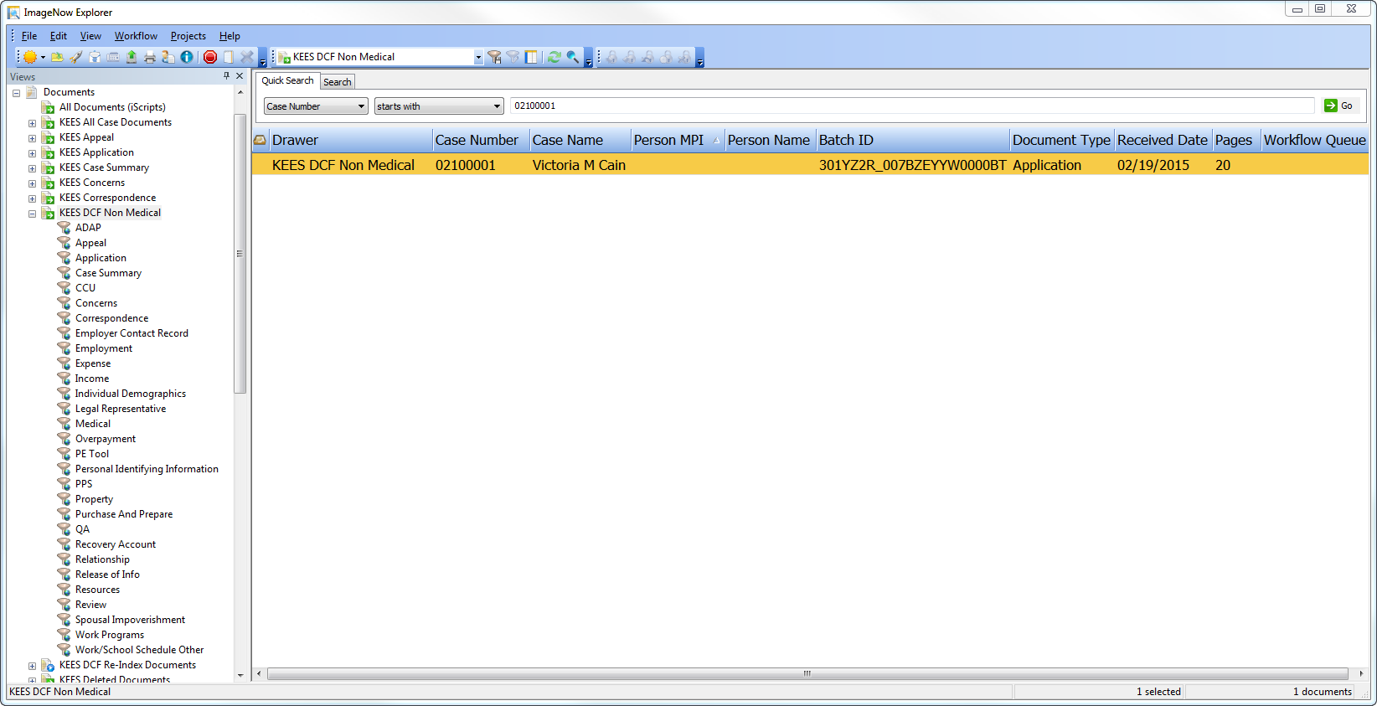
Imaging: DCF
Lesson 5: Document Management > Retrieval in ImageNow
Notes:
Interactive Slide
Once you have entered your search criteria. You would click the word “Go.” which is Step 5 of this process.
Step 6. The search results page will display with the list of documents. Double click the document you want to view.

Slide 67
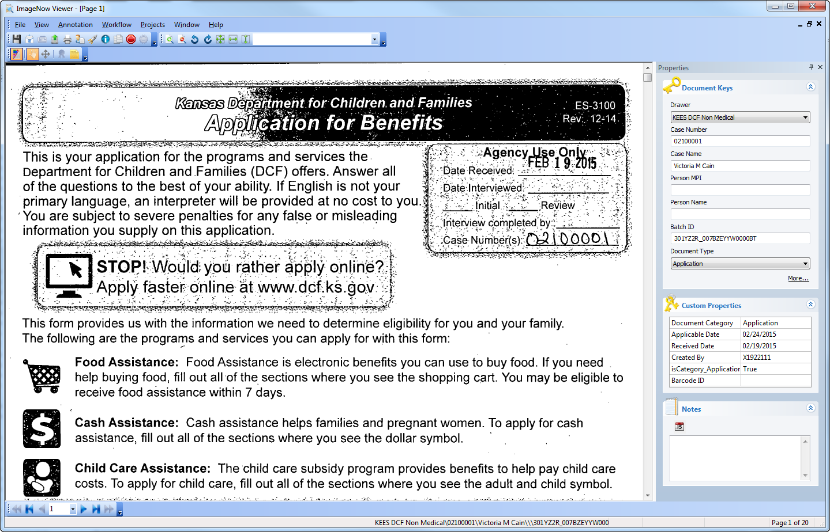
Imaging: DCF
Lesson 5: Document Management > Retrieval in ImageNow
Notes:
Step 7. The Document will open in the ImageNowViewer.
To close the document, select the “X” in the upper right-hand corner.

Slide 68
Imaging: DCF
Lesson 5: Document Management > Copy A Document
The ImageNow Copy Document function allows a user to:
  Make a copy of one or more pages of a document, and
  Change the document keys for those pages
Changing the document keys will distinguish the copied document from the original document.
1
1

Slide 69
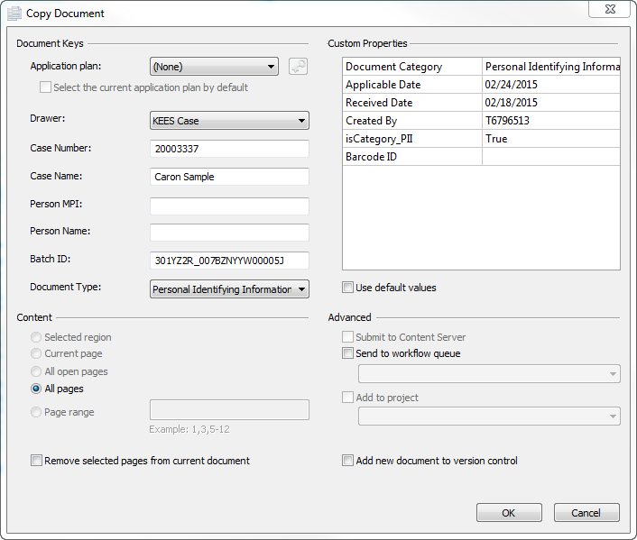
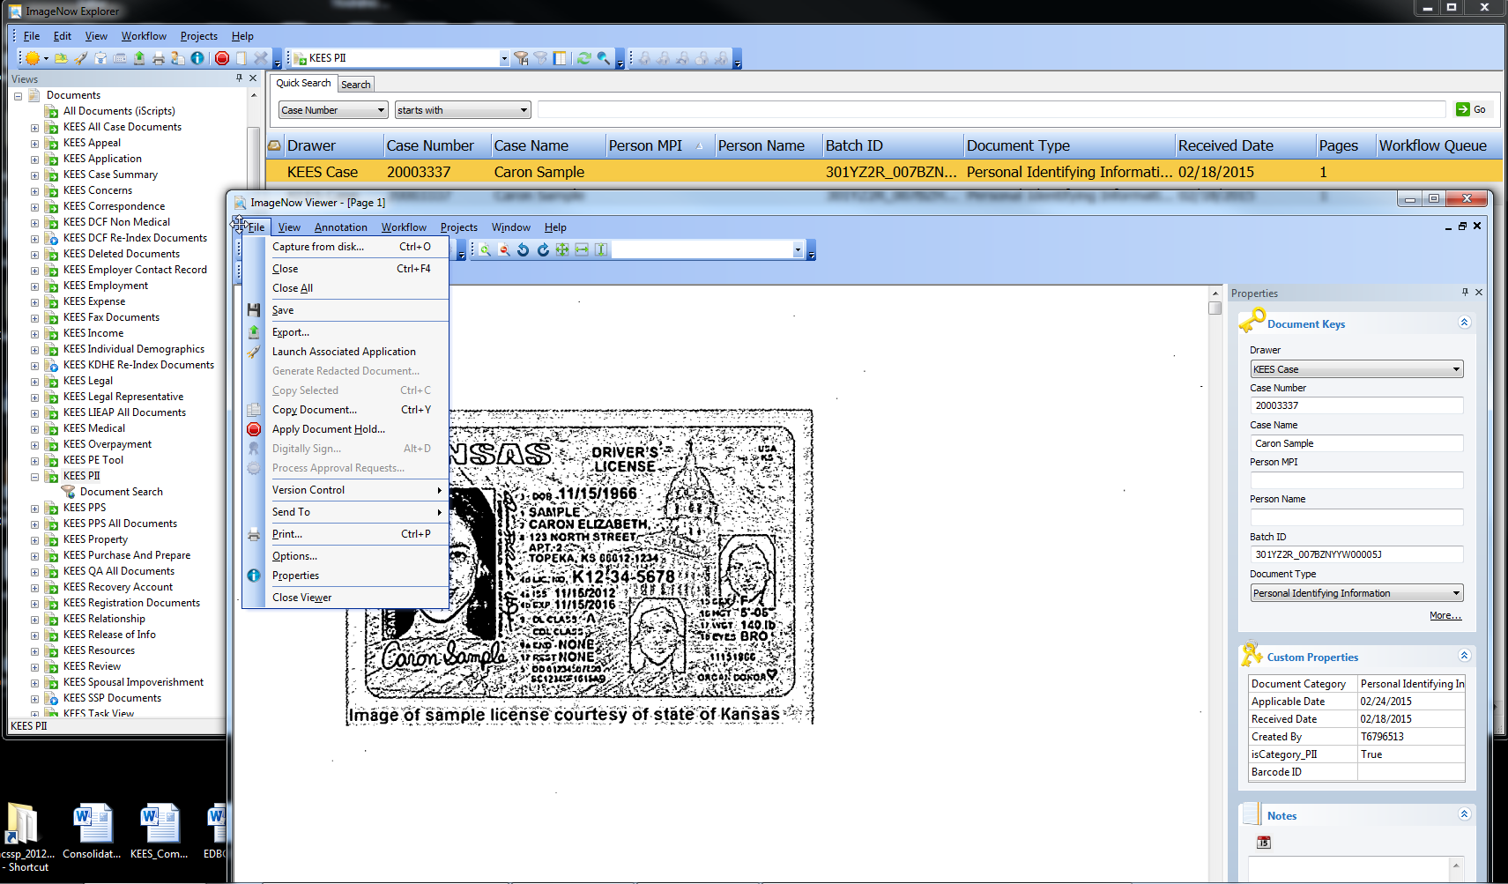
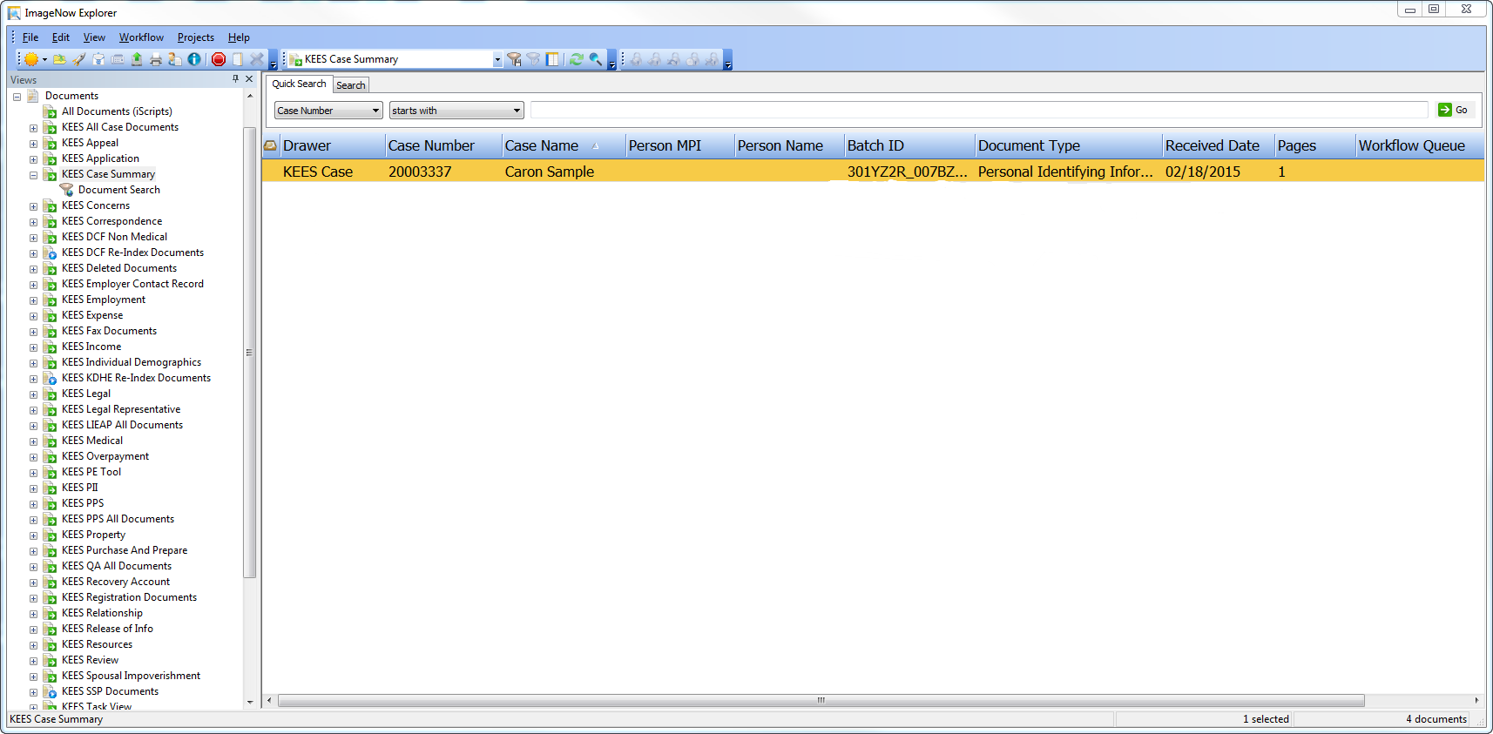
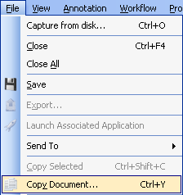
Imaging: DCF
Lesson 5: Document Management > Copy A Document
A document originally pertained to a Medical case, but now also pertains to a Non-Medical case. A user will need to copy the applicable pages of the original document and associate it to the non-medical case.
Notes:
Interactive Slide
First we need to open the document needing to be copied in the ImageNow Viewer. Open the document to verify you have the correct image. (Interactive Screen)
Next we will Select File and Copy Document. (Interactive Screen) The Copy Document dialog will open.

Slide 70
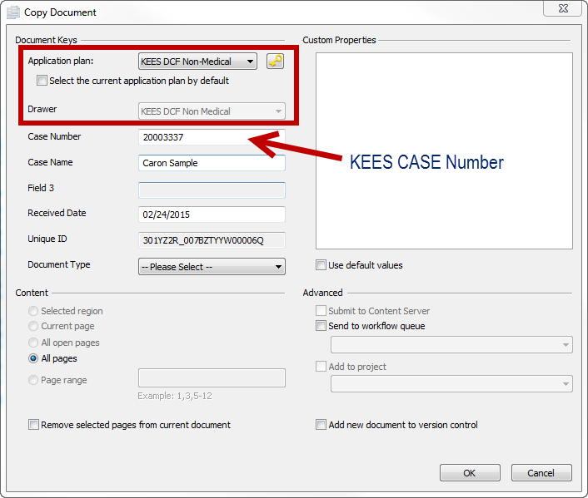
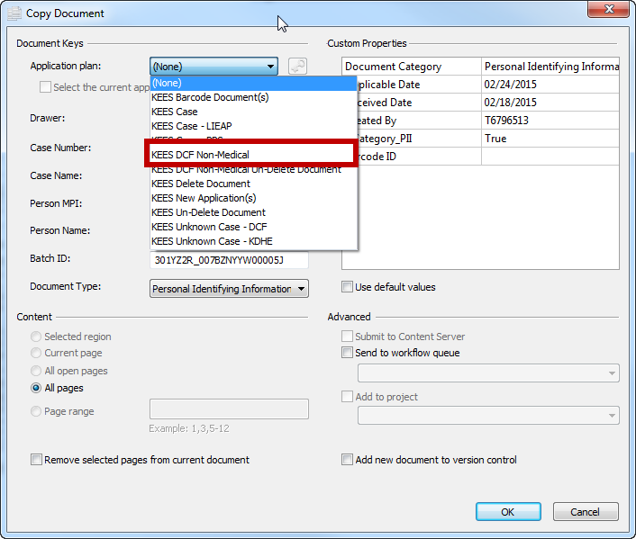
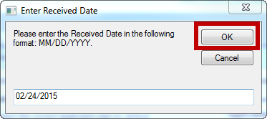
Imaging: DCF
Lesson 5: Document Management > Copy A Document
Notes:
Interactive Slide
Next we will select KEES DCF Non-Medical Application Plan.
The Enter Received Date window will appear. We will just click on “Ok”. (Interactive Slide)
The Copy Document window will appear with the New Application Plan but with KEES case number.
Step 4: Manually enter the KAECSES case information in the Case Number, Case Name, Receive Date & Document Type in the applicable index values.
Step 5: In the Content section, select the appropriate radio button, or enter the Page range to indicate the pages to be copied.
Step 6: Confirm the Remove select pages from current document checkbox IS NOT selected.
Step 7: Select OK
The Copy Document dialog closes and the original document is present in the ImageNow Viewer. (Note: The new document has been created; retrieve the document by searching for the document keys applied in Step 4.)

Slide 71
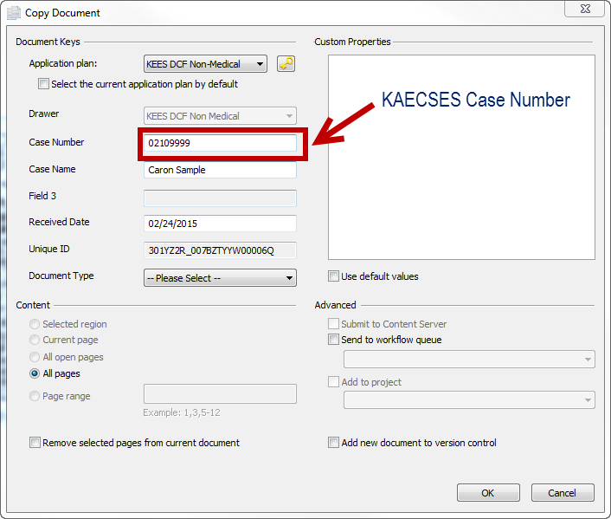
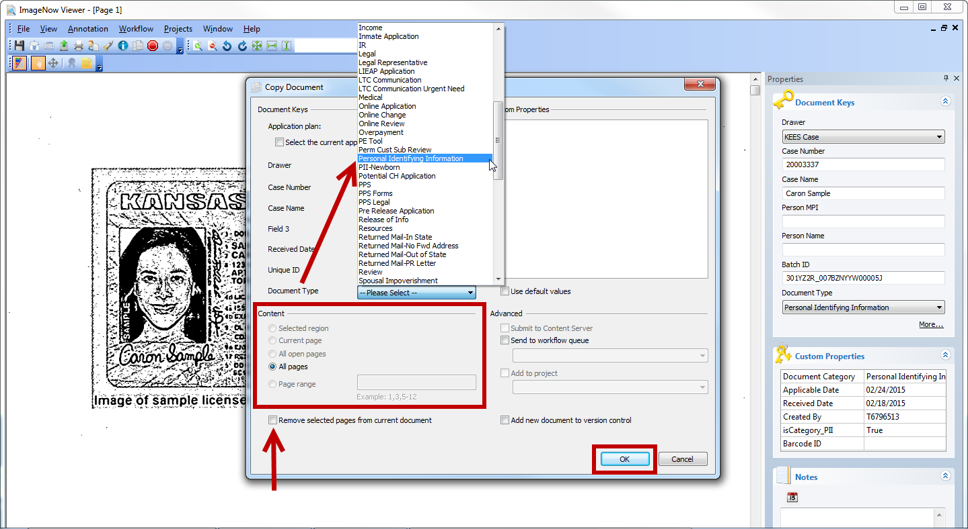
Imaging: DCF
Lesson 5: Document Management > Copy A Document
Notes:
Interactive Slide
Next manually enter the KAECSES case information in the Case Number, Case Name, Receive Date.
If applicable select the Document Type from the drop-down.
In the Content section, select the appropriate radio button, or enter the Page range to indicate the pages to be copied.
Then confirm the Remove select pages from current document checkbox IS NOT selected.
The last step is select OK
The Copy Document dialog closes and the original document is present in the ImageNow Viewer.

Slide 72
Imaging: DCF
Lesson 5: Document Management > Document Split
The KEES Indexing eForm allows users to complete re-indexing and additional indexing when necessary. The indexing options include: Step 2 Person Level indexing, Received Date, and Document Category/Type. The Indexing eForm is only applicable to KEES case numbers because it validates the case number.
1
2
3

Slide 73
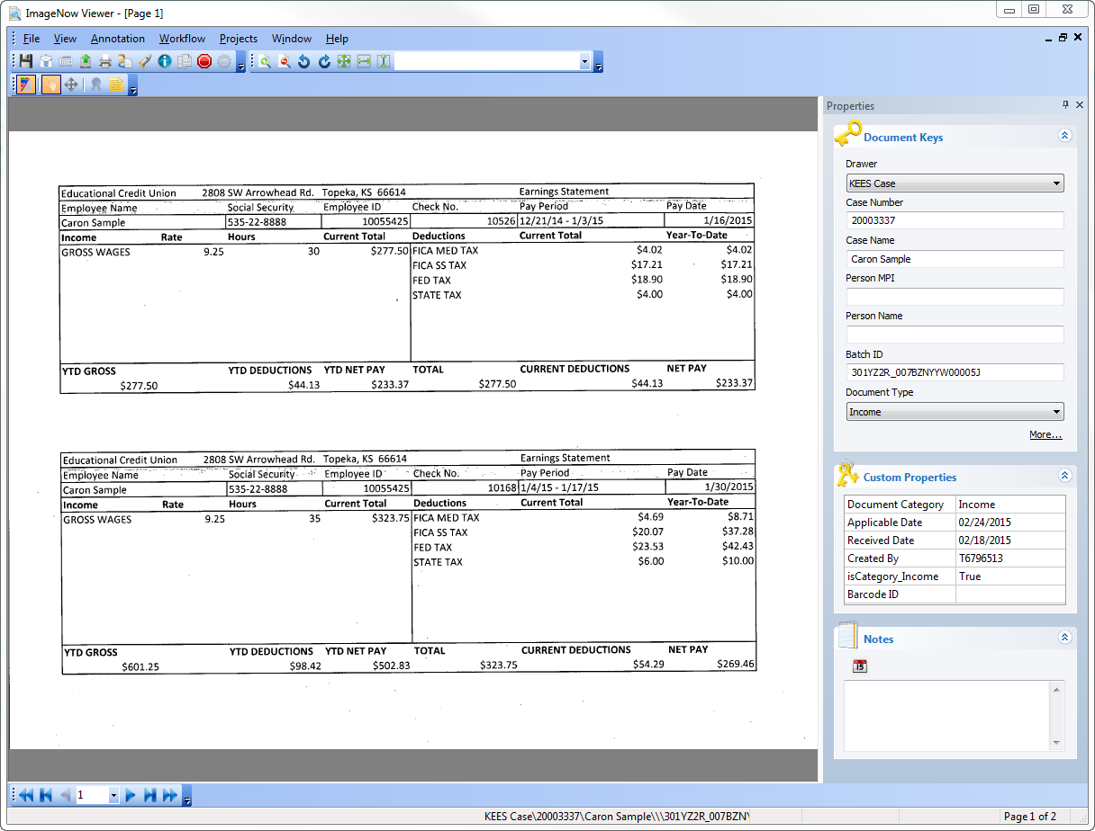
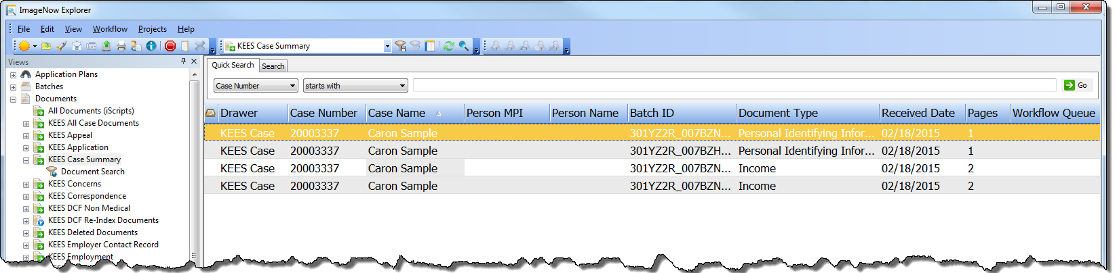
Imaging: DCF
Lesson 5: Document Management > Document Split
Splitting a document allows a user to move selected pages from the original document and then use those pages to create a new document with unique index values.
We will be using the KEES Indexing eForm for this process for KEES Medical cases only.
Notes:
Interactive Slide
Splitting a document will be required of all applications and supporting documents received through both the Lobby and Non-Lobby processes, if more than one document type.
Our first step is to search and Open the document needing to be split in the ImageNow Viewer.

Slide 74
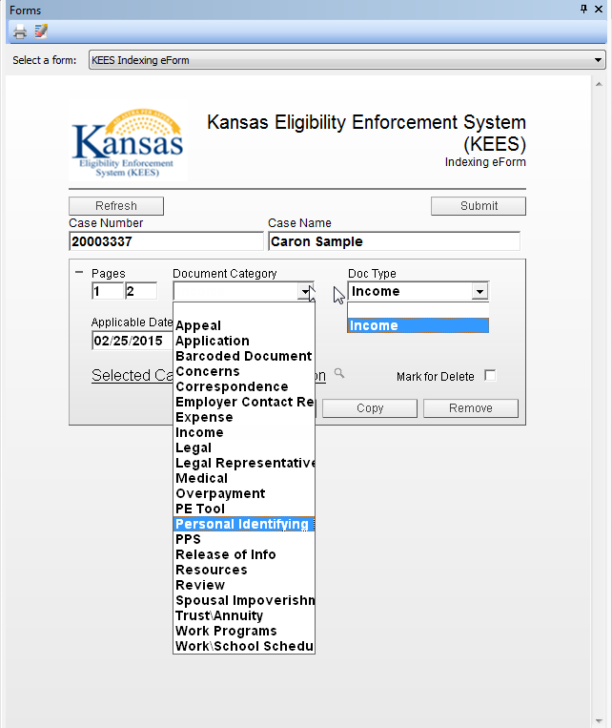
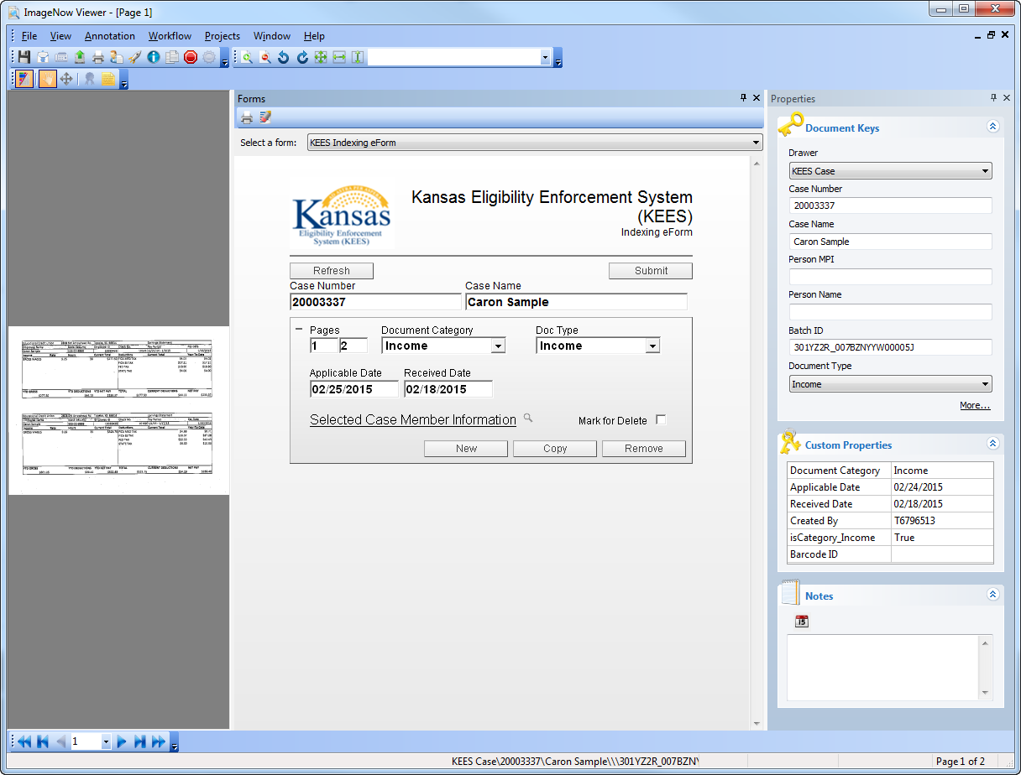

Imaging: DCF
Lesson 5: Document Management > Document Split
Notes:
Interactive Slide
Open the KEES Indexing Form by Selecting View, Form or by hitting F12.
Then select the designated Page range by selecting the specified Page number ranger.
Next select the appropriate Document Category and the Doc Type values from the drop-down list. The Doc Type list will vary in values depending upon your Document Category.

Slide 75



Imaging: DCF
Lesson 5: Document Management > Document Split
Notes:
Interactive Slide
Then select the Copy on the eForm.
The following message will appear, letting you know that the pages have been assigned. You would select “OK”.
The last step of this process is the select the “Submit” button to split the designated page range from the original document and create the new document referencing to the Case Number or Case Name.

Slide 76
Imaging: DCF
Lesson 5: Document Management > Re-Indexing
Re-Indexing
  When
    A user captures a document with an unknown case number
    A user mistakenly scans a document while viewing the wrong Case Summary Page in the KEES system
  Who
    Users with access to the ImageNow Indexing eForm will have the ability to re-index documents
    Other users may come across misplaced index documents
  Users should always be on the KEES Case Summary Page that corresponds to the case number where you want the document to end up before opening the document that requires re-indexing in the ImageNow Viewer.
Notes:
Let’s walk through this process.

Slide 77

Imaging: DCF
Lesson 5: Document Management > Re-Indexing
Step 1. Navigate to the Case Summary page for the case you want to associate to the documents.
Notes:
You must be in the context of the case and on the KEES Case Summary page in order to auto-populate the Case Number and the Case Name for this process to work.

Slide 78


Imaging: DCF
Lesson 5: Document Management > Re-Indexing
Step 2. Click the drop-down caret next to the Documents button on the ImageNow toolbar and select KEES Unknown Case Documents as the desired Document View Filter.
Notes:
Interactive Slide
If you know the type of document that you are looking for you could also select the document type.

Slide 79


Imaging: DCF
Lesson 5: Document Management > Re-Indexing
Step 4. Use the Quick Search parameters to retrieve desired document to re-index.
Notes:
Interactive Slide
Once you have entered your search criteria. You would click the word “Go.”

Slide 80


Imaging: DCF
Lesson 5: Document Management > Re-Indexing
Step 6. Double Click the document you want to view. The document will open the ImageNow Viewer.
Notes:
Interactive Slide
On the ImageNow Viewer, view the KEES Indexing eForm. Don’t forget you can use the shortcut of F12.

Slide 81


Imaging: DCF
Lesson 5: Document Management > Re-Indexing
Step 8. Update the values in the appropriate eForm fields. Click the Submit button.
Notes:
Interactive Slide
The following prompt will display. Select “Ok.”

Slide 82

Imaging: DCF
Lesson 5: Document Management > Case vs Person
Initially all documents are associated to a case. For personal identifying information (PII) do second level indexing to the individual using Indexing eForm.
Case Indexing
Person Indexing
Notes:
Person Level Indexing vs. Case Level Indexing:
Person level documents follow the person from case to case. Some of examples include personal identifying documents such as birth certificates, driver’s licenses, passports, and social security cards. These documents are indexed at the person level.
Example: Sarah and her two children have a Medical Assistance case. All personal identifying documents for Sarah and her two children have been provided to the Clearinghouse. Sarah later applies for Food Assistance for her two children. All personal identifying documents will also be accessible through the non-medical case number.
Images tied to a KAECSES case number cannot be indexed to the person level with Phase 2 implementation.
Case level documents do not follow a person from case to case. Some examples include landlord letters and paycheck stubs. These documents are indexed at the case level.
Example: Sarah has a Food Assistance case on case number 123. She is employed and her paycheck stubs are indexed to the income folder for case number 123. Sarah later moves in with her boyfriend and starts receiving Food Assistance on case number 456. Her paycheck stubs will not be in the income folder for case number 456.
DCF’s expectation is to image documents to the person level whenever appropriate.
When an image cannot be associated to a person or a case it will be stored within the "Unknown" document drawer within ImageNow.

Slide 83

Imaging: DCF
Lesson 5: Document Management > Case vs Person
Case Level Indexing: Case Documents will be Indexed to the Case Number, Case Name and Document Type. Example: 1234, Jane Doe/Income
Feld / Property | Description
Drawer | Auto Populated to KEES Case by ImageNow.
Case Number | Case Number in KEES. Verify during QA step.
Case Name | Person Name in KEES
Field 3 | <Undefined Field>
Received Date | Date document is received.
Unique ID | Temporary Unique ID for system.
Document Type | Categorizes a document.
The following describes and displays the index fields for Case Level Documents.

Slide 84

Imaging: DCF
Lesson 5: Document Management > Case vs Person
Person level documents follow the person from case to case.
Some of examples include personal identifying documents such as birth certificates, driver’s licenses, passports, and social security cards. These documents are indexed at the person level.
Notes:
Let’s look an example of how to index to the person level.

Slide 85
Imaging: DCF
Lesson 5: Document Management > 2nd Level Person Indexing
2nd Level Person Indexing is required for documents containing Personal Identification. These documents are applicable to multiple cases and deemed “durable and portable.”
To complete 2nd Level Person Indexing:
Enter or update the indexing information on the KEES Indexing eForm for all fields that apply.
May require document splitting.
  Complete this by selecting the eForm’s New or Copy button and entering the person level information accordingly.

Slide 86

Imaging: DCF
Lesson 5: Document Management > 2nd Level Indexing
Select the PII document by double clicking on the designated line and will display in the ImageNow viewer.
Notes:
Step 1. Navigate to the Case Summary Screen
Step 2. Find and click on the Images button found on the upper right hand corner of the Case Summary Screen.
Step 3. Select the PII document by double clicking on the designated line and will display in the ImageNow viewer.

Slide 87


Imaging: DCF
Lesson 5: Document Management > 2nd Level Indexing
After double clicking on the Personal Identification Information (PII) document and access the eForm.
Notes:
Interactive Slide
Step 4: Click View/Forms or F12 to display the KEES Indexing eForm.
Step 5: Utilizing the drop down functionality for Document Category, select the appropriate Document Category.
Step 6:Then select the appropriate Document Type

Slide 88



Imaging: DCF
Lesson 5: Document Management > 2nd Level Indexing
Click on the magnifying glass to search for the Selected Case Member Information.
Notes:
Interactive Slide
Step 7: Click on Magnifying Glass to search for the Selected Case Member Information.
Step 8: Select the correct member of the Family displayed. Click <OK>

Slide 89


Imaging: DCF
Lesson 5: Document Management > 2nd Level Indexing
Verify that your case member matches your image. Then select the “Submit” button.
Notes:
Interactive Slide
Step 9: Select the Submit button in the upper right hand corner of the eForm.
The following prompt will appear and we will select “OK”
NOTE: If there are more pages to copy/split from original image, follow these steps until completely re-indexed the ‘bundled’ document.

Slide 90
Imaging: DCF
Lesson 5: Document Management > Search Criteria
The UNKNOWN Drawer
First Name and Last Name are required indexing fields. If First and/or Last name is unknown, staff are to enter “Unknown” in the corresponding field(s).
DCF also has a need to search on location since the UNKNOWN drawer is Statewide and stretches across multiple offices.
Staff are to enter the Office Location in the First Name field along with the name, for example:
  If First Name is known: “Topeka Jane” and if not known “Topeka Unknown”
  If Last Name is known: “Topeka Doe” and if not known “Topeka Unknown”

Slide 91

Imaging: DCF
Lesson 5: Document Management > Document Management
The agency will be able to print documents from the ImageNow solution when a consumer has requested them.
Print Document: If needed, a document can be printed upon request through the File Menu or Print icon options from the ImageNow Viewer Toolbar.

Slide 92
Imaging: DCF
Lesson 5: Document Management > Summary
In Lesson 5, workers learned:
Document retrieval
Splitting and copying a document
Indexing a document to the 2nd Person Level
Re-Indexing a DCF Non-Medical document to the correct case and document type

Slide 93
Imaging: DCF
Agenda
Lesson 1: What is Imaging?
Lesson 2: Sorting Documents
Lesson 3: ImageNow Fundamentals
Lesson 4: Document Processing
Lesson 5: Document Management
Lesson 6: Troubleshooting

Slide 94
Imaging: DCF
Lesson 6: Troubleshooting > Introduction
This unit provides an overview of document management and troubleshooting in the KEES Imaging System.
After completing this lesson, you will learn ways to Troubleshoot issues.

Slide 95
Imaging: DCF
Lesson 6: Troubleshooting > Troubleshooting
Troubleshooting
A large part of efficiently mastering any application is learning how to troubleshoot problems effectively.
The first step of any troubleshooting scenario is identifying exactly what the problem is. From there, the end-user can then decide on how best to resolve that issue.
We will detail issues you may come across:
  Document in Working Status
  Cannot Find Appropriate KEES Screen for Linking
Notes:
Here we will be posed with two different types of issues users may find in ImageNow

Slide 96

Imaging: DCF
Lesson 6: Troubleshooting > Issue #1
Issue 1: Document is stuck in Working Status:
This means that a document cannot pass through the workflow because it is locked by another user. There are a few reasons why this may happen.
A user may have had this document open when their computer crashed leaving it in a working status.
A user may have opened the document, and then left their workstation for an extended period.
Notes:
Steps to move document out of Working Status:
Locate document in ImageNow Explorer through Search
Right click on document line
Scroll down to ‘Workflow’
Second pop-up menu will appear. “Select Mark Item as Pending”
NOTE: Not everyone will have this security right. If the document is stuck, please reach out your supervisor to move the document out of a working status.

Slide 97

Imaging: DCF
Lesson 6: Troubleshooting > Issue #2
Issue 2: ImageNow Cannot Find The KEES Screen
This issue can be alerted to the user in a variety of ways. The user may receive a dialog box that says something similar to:
  “Could not find an application window or the application plan is trying to use an invalid drawer…”
In the event that you may see this error you can check the following:
  The Application Plan in ImageNow
  Are you still logged in KEES?
  Check the Unknown Drawer
  Check the specific document drawer

Slide 98
Imaging: DCF
Course Summary
In this course, we have looked at:
The benefits of the KEES Imaging Solution
Understanding the basic functionality and how it affects day-to-day tasks
Hot versus Cold document processing
Lobby processes and cover sheets
Non-Lobby processes
Why and how to index to the Unknown drawer

Slide 99
Imaging: DCF
Course Summary Continued
In this course, we have also learned:
Imaging processes and definitions
The two ways to capture
DCF capture profiles to be used for Phase 2
Setting Default Capture Profiles
Viewing Applications and Supporting Documents
Document Management
Troubleshooting

Slide 100
Imaging: DCF
Questions
Notes:
version 2.0

