Slide 1
Medical Eligibility
Imaging for DCF Support Staff
Notes:
Welcome participants to the training session.
Cover any housekeeping items such as:
The location of restrooms and breakrooms.
Ground rules for the training.
Instructor introductions.
Participant introductions.
Transition: Let’s talk about why we’re all here.

Slide 2
Medical Eligibility: Imaging for DCF Support Staff
Introduction
This course provides an overview of the fundamentals of imaging and explains the business process as it relates to the Imaging Solution for Support Staff.

Slide 3
Medical Eligibility: Imaging for DCF Support Staff
Agenda
Lesson 1: KEES Business Process
Lesson 2: ImageNow Basics
Lesson 3: Imaging
Lesson 4: IN Printing- CAPP Application
Lesson 5: 2nd Level Indexing/Copy a Document

Slide 4
Medical Eligibility: Imaging for DCF Support Staff
Introduction
After completing this course, you will be able to:
Identify ‘Hot’ or ‘Cold’ documents
Batch and capture documents
Perform imaging duties (tasks)

Slide 5
Medical Eligibility: Imaging for DCF Support Staff
Lesson 1: KEES Business Process
ImageNow
Ensures that all documents are secure, quickly retrievable, and associated to the files and applications you want.
Captures and manages images from:
SSP
Applications/Reviews
Supporting Documents
Journaling
Email, MS Office or PDF (electronic)
Gives workers the ability to view, scan, process and search for documents.

Slide 6
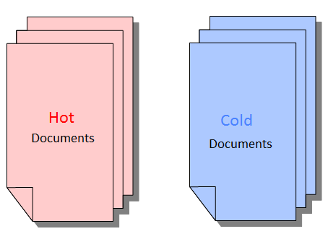
Medical Eligibility: Imaging for DCF Support Staff
Lesson 1: KEES Business Process
Applications and Reviews will be registered and then imaged as either hot or cold based on the case status.
What is Hot?
Unworked or unprocessed document(s).
24 hour turnaround: Must be imaged same day-no later than next day.
If an eligibility determination is not made on an application received through the lobby.
All Documents to be routed to the Clearinghouse.
All documents received via non-lobby.
What is Cold?
Case information that requires no further action. For example, supporting documentation from a lobby interview, historical documents, and/or file only documentation.
Cold documents must be imaged within 3-5 days of receipt.

Slide 7
Medical Eligibility: Imaging for Support Staff
Lesson 1: KEES Business Process
Open mail, date stamp the front of each page, and then sort by the line of business (e.g. EES, VR, PPS, APS, CSS, Legal, Operations, LIEAP, and Administration).
EES Documents:
Apply screening criteria:
Acceptable signature
“Big 4” criteria for Medical
Expedited Food Assistance
Sort documents into baskets accordingly (e.g. DCF Medical Application, DCF Non-Medical Application, CH Application, Expedited Food Assistance, Interim Reports, Non-Medical Reviews, Reviews, Unsigned Mail, Returned Mail, and Loose Mail).
Prepare documents for Registration and/or Imaging
Remove Staples
Fix Tears
Make copies of original documents and send originals back to consumers

Slide 8
Medical Eligibility: Imaging for Support Staff
Lesson 1: KEES Business Process
Batch in groups of 25 (if applicable) with completed Non-Lobby Tracking Sheet
Paperclip documents received in the same envelope together (e.g. an application with all supporting documents is considered 1 “envelope”, loose mail from the same client includes paystubs, utility bill, and school records, this is considered 1 “envelope”). Each batch should have 25 “envelopes” if applicable.
Deliver batches to the correct location:
CH Applications, Returned Mail and Loose Mail to the Hot Imaging Basket
DCF Applications, Reviews and IR’s with supporting documents to the
Registration Basket
Cold documents to the Cold Imaging Basket
Unsigned documents returned to client per policy
Notes:
The number 25 was chosen so that a quick count of pending work could be counted. For example, if the Supervisor asked a specific team at any time how many reviews or applications needed to be processed, they could quickly determine there were 8 stacks of batched items and could determine there were 200 cases needing processed.
If your office does not receive the volume of mail to make a batch of 25 do not hold the Imaging Tracking Sheet. Place the batch in the applicable basket as soon as sorting/screening is complete.

Slide 9
Medical Eligibility: Imaging for Support Staff
Lesson 1: KEES Business Process
Register DCF Non-Medical and Medical applications, reviews, and interim reports.
Write Case Head and Case # on documents
Place document batch in the HOT Imaging Basket
Scan and index documents to ImageNow.
Image according to priority
Scan each envelope separately, indexing each item accurately
After imaging, staple documents together
Generate manual tasks for the appropriate queue
Return tracking sheet and rubber band completed batches as a visual cue that the batch is complete
Place completed batches into the 60 day retention area by scanned date

Slide 10
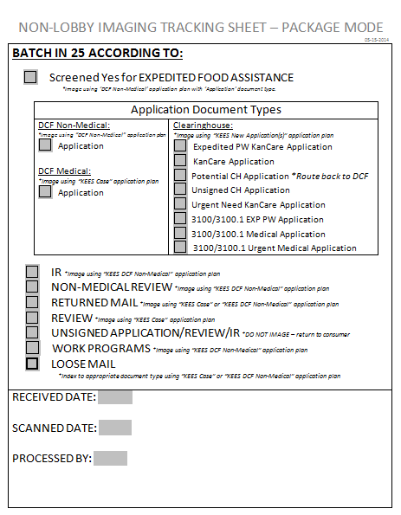
Medical Eligibility: Imaging for DCF Support Staff
Lesson 1: KEES Business Process
The Non-Lobby Image Tracking Sheet
Assists with sorting Non-Lobby Documents
Identifies the ImageNow application plan & document type
Check the applicable box to identify the document batch & document type.
Received Date must match date stamp.
Attach tracking sheet to the documents and place in applicable basket. Maximum of 25 documents per tracking sheet.
Registration staff will return Image Tracking Sheet to document batch and place batch in Hot Imaging Basket.
The imager enters Scanned Date and Processed By.
The Tracking Sheet is not imaged.

Slide 11
Medical Eligibility: Imaging for DCF Support Staff
Lesson 1: KEES Business Process
Lobby documents will be registered and/or placed in the applicable imaging basket with the Lobby Tracking Sheet. DCF applications and reviews received via the lobby process will be registered by the worker during the interview.

Slide 12
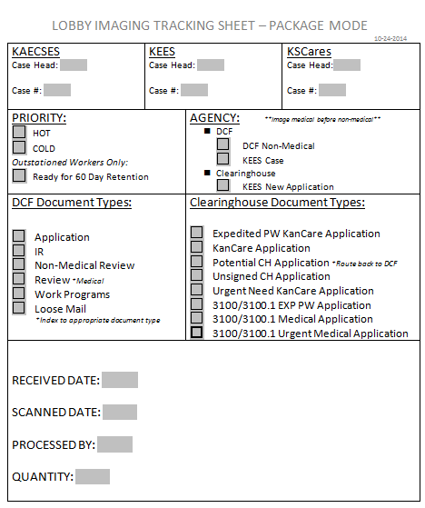
Medical Eligibility: Imaging for DCF Support Staff
Lesson 1: KEES Business Process
The Lobby Imaging Tracking Sheet is used by workers after completing a lobby interview.
The tracking sheet will be completed and attached to the documents received during the interview and placed in either the hot or cold imaging basket.
The tracking sheet will not be imaged.

Slide 13
Medical Eligibility: Imaging for DCF Support Staff
Summary
In this lesson we looked at the business process for Imaging.
We reviewed:
What makes a document “Hot” or “Cold”
Process for opening mail, date stamping & sorting
Process for screening, batching, registering, imaging and document retention
Next we will look at ImageNow basics.

Slide 14
Medical Eligibility: Imaging for DCF Support Staff
Agenda
Lesson 1: KEES Business Process
Lesson 2: ImageNow Basics
Lesson 3: Imaging
Lesson 4: IN Printing- CAPP Application
Lesson 5: 2nd Level Indexing/Copy a Document

Slide 15
Medical Eligibility: Imaging for DCF Support Staff
Lesson 2: ImageNow Basics > Introduction
All ImageNow functions have the same basic steps:
Launch ImageNow & log in
Set Capture Profile
Set Application Plan
Prepare documents to be loaded into scanner
Capture document to the correct Package basket and document type
Index/re-index
Quality Assurance: Visually confirm the captured image is of good quality and that documents are captured and indexed to the correct case number, document type, etc.
Save/submit document to finalize imaging
Set applicable Manual Tasks
Document Storage- 60 day retention area

Slide 16
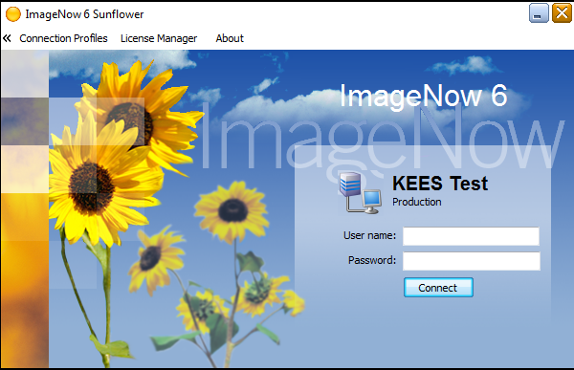
Medical Eligibility: Imaging for DCF Support Staff
Lesson 2: ImageNow Basics > Launch ImageNow
Launch ImageNow
Log in to ImageNow
KEES User name
Password
Notes:
ImageNow can be accessed via a shortcut on your desktop, the menu bar at the bottom of your screen, or through the start-up menu.

Slide 17
Medical Eligibility: Imaging for DCF Support Staff
Lesson 2: ImageNow Basics > Package Mode
Locate the Capture button. Set Package Mode as the default. DCF will always use Package Mode when capturing physical documents. This allows an individual to scan several types of documents for the same case at one time.
Once “Package Mode” is set as the default, the worker will not need to set this again unless using a different imaging station.
Notes:
The following steps will set the default Capture mode:
Click the Capture drop-down caret
Right click on the Package Mode
Select Set as Default Action

Slide 18
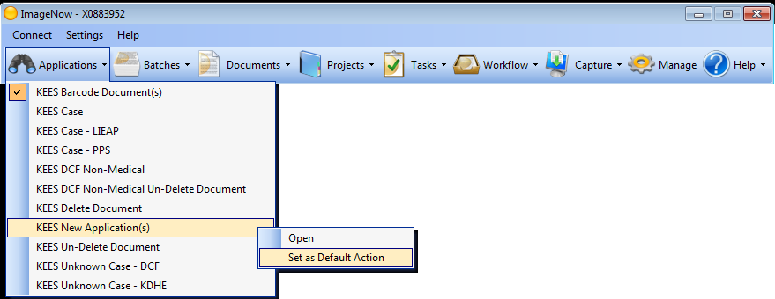
Medical Eligibility: Imaging for DCF Support Staff
Lesson 2: ImageNow Basics > Application Plan
Application Plan
On the ImageNow toolbar, navigate to the Applications drop-down menu and click the caret to select the desired Application Plan.
Application Plans are containers that store mapped information used to assign drawer, document key, and custom property values to captured documents.

Slide 19
Medical Eligibility: Imaging for DCF Support Staff
Lesson 2: ImageNow Basics > Application Plans
Application Plans:
KEES Barcode Document: Use for any document with a KEES generated barcode
KEES Case: Use for any document tied to a DCF medical program and the KEES case number is known
KEES Case PPS: Use for any document related to a PPS medical program and the case number is known
KEES DCF Non-Medical: Use for any document tied to a non-medical program and the case number is known
KEES Deleted Document: Documents deleted from a KEES document drawer will be re-indexed to this application plan
KEES New Application: Always use when routing an application to the Clearinghouse
KEES Unknown Case-DCF: Use when a document is received at DCF and cannot be tied to a person and/or a case number

Slide 20
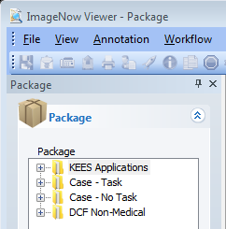
Medical Eligibility: Imaging for DCF Support Staff
Lesson 2: ImageNow Basics > Package Basket
Package Baskets:
KEES Application: Used to route work to the Clearinghouse. All tasks will be automatically generated by the image with a due date, task name and assigned queue.
Case- Task: Not used by DCF during Medical Go-Live.
Case- No Task: Used for DCF medical programs and PPS medical programs. A manual task will need to be created if appropriate after a document is imaged. Medical programs should have a KEES case number before a document is imaged.
DCF Non-Medical: Used by DCF for all Non-Medical programs. A manually generated task will need to be created if appropriate after a document is imaged. Non-Medical programs will not have a KEES case number.

Slide 21
Medical Eligibility: Imaging for DCF Support Staff
Lesson 2: ImageNow Basics > Indexing
Indexing:
If applications or reviews have supplemental documents attached, support staff will index to the appropriate document type within the KEES case or KEES DCF Non-Medical Drawer. Users can split the documents to correct document types before submitting the images or can choose to drag and drop later.
When routing applications to the Clearinghouse, DCF staff are NOT expected to index the supporting documents.
Personal Identifying Information can only be indexed to the “person level” on Medical cases. The process requires ImageNow to pull household member information from the KEES case via the eForm to associate the “person level” document to the specific household member.

Slide 22
Medical Eligibility: Imaging for DCF Support Staff
Lesson 2: ImageNow Basics > Case Level vs. Person Level
Documents that are received from the consumer will be imaged and indexed at either a person level or case level.
Case level:
Document is associated to the case, not a specific person
Includes general documents (i.e. applications, reviews, pay stubs)
Person level:
Document follows the person from case to case
Includes personal identifying documents (i.e. birth certificates, ID, social security card)

Slide 23
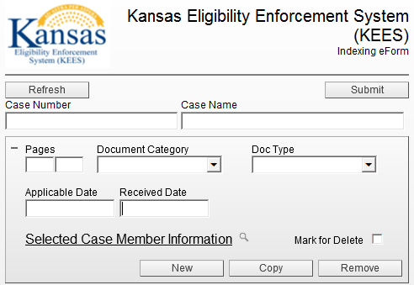
Medical Eligibility: Imaging for DCF Support Staff
Lesson 2: ImageNow Basics > Indexing eForm
Indexing eForm:
Tool used to correct any indexing mistakes.
Allows users to index a document to a specific case person.
Used to Re-index a document to a different case number.
Index eForm functionality applies to KEES case numbers only.

Slide 24
Medical Eligibility: Imaging for DCF Support Staff
Lesson 2: ImageNow Basics > The Unknown Drawer
The Unknown Drawer:
When a document is received and cannot be associated to a person or a case, it will be imaged and stored within the “Unknown” drawer.
This document drawer will be shared statewide among all DCF KEES users.
DCF is going to allow Eligibility Workers to look in the drawer and re-index “Unknown” documents as needed.
Each office is to designate one person to manage and routinely clean-up the drawer as well.

Slide 25
Medical Eligibility: Imaging for DCF Support Staff
Lesson 2: ImageNow Basics > The Unknown Drawer
The Unknown Drawer:
First Name and Last Name are required indexing fields. If first and/or
last name is unknown, staff are to enter “Unknown” in the corresponding field(s).
Staff are to enter the Office Location in the First Name field along with the name.
If First Name is known: “Topeka Jane” and if not known “Topeka Unknown”
If Last Name is known: “Topeka Doe” and if not known “Topeka Unknown”

Slide 26
Medical Eligibility: Imaging for DCF Support Staff
Summary
In this lesson we looked at the basics of Imaging:
How to Launch and Log In to ImageNow
Capture and Application Plans
Preparing documents to be loaded into scanner
Capture document to the correct Package basket and document type
Indexing/re-indexing
Quality
Saving/submitting document to finalize imaging
Setting applicable Manual Tasks
Document Storage- 60 day retention area

Slide 27
Medical Eligibility: Imaging for DCF Support Staff
Agenda
Lesson 1: KEES Business Process
Lesson 2: ImageNow Basics
Lesson 3: Imaging
Lesson 4: In Printing- CAPP Application
Lesson 5: 2nd Level Indexing/Copy a Document

Slide 28
Medical Eligibility: Imaging for DCF Support Staff
Lesson 3: Imaging > Introduction
In this lesson we will learn:
How to Screen for the Big 4
How to Image an Application received at DCF that needs to go to the Clearinghouse
How to Image a DCF Medical Application

Slide 29
Medical Eligibility: Imaging for DCF Support Staff
Lesson 3: Imaging > Screening for the Big 4

Slide 30
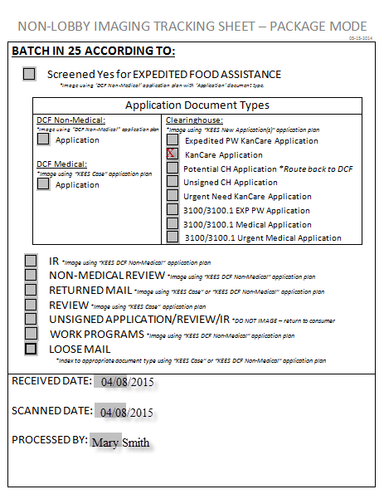
Medical Eligibility: Imaging for DCF Support Staff
Lesson 3: Imaging > Medical Application for the Clearinghouse
Capture and Image a Medical Application received at DCF for the Clearinghouse
Complete the Non-Lobby Imaging Tracking Sheet and attach to the application and supporting documents.
Place documents in the HOT basket.

Slide 31
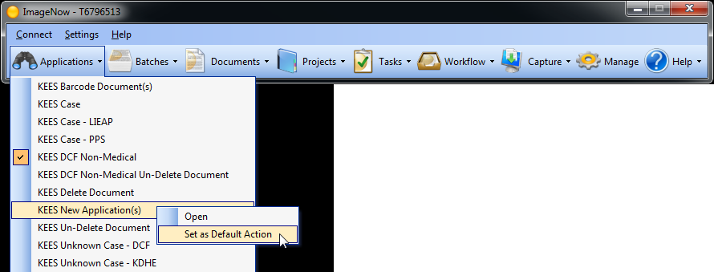
Medical Eligibility: Imaging for DCF Support Staff
Lesson 3: Imaging > Medical Application for the Clearinghouse
Access ImageNow
Set KEES New Application(s) as the default application plan.

Slide 32
Medical Eligibility: Imaging for DCF Support Staff
Lesson 3: Imaging > Medical Application for the Clearinghouse
Check the Capture Profile to verify that it is set to Package Mode.
Notes:
The user can verify that the Capture Profile is set to Package Mode by hovering over the button.

Slide 33
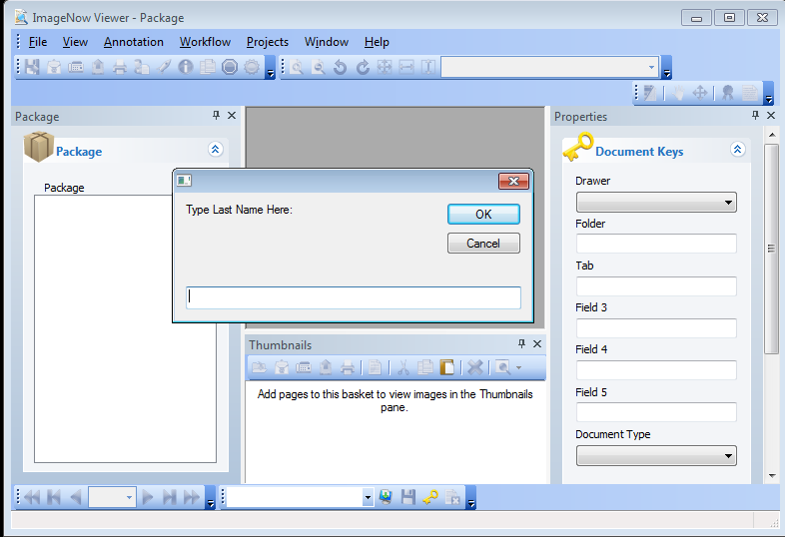
Medical Eligibility: Imaging for DCF Support Staff
Lesson 3: Imaging > Medical Application for the Clearinghouse
The Type Last Name Here: dialog box will display. Enter the applicant’s last name and click the OK button.

Slide 34
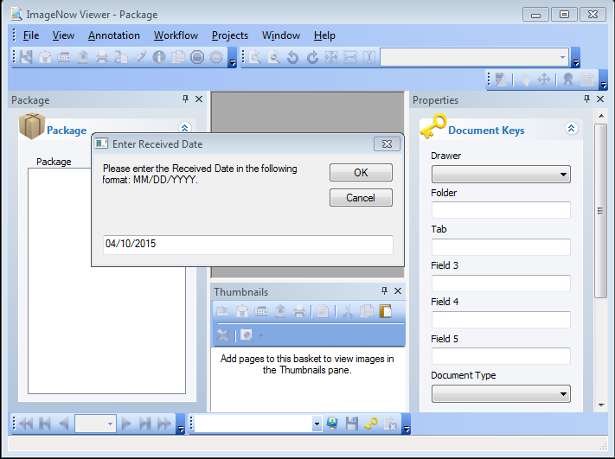
Medical Eligibility: Imaging for DCF Support Staff
Lesson 3: Imaging > Medical Application for the Clearinghouse
The Enter Received Date dialog box will display with the current date populated. Workers will need to update that field to the date that the document was date stamped and then click the OK button.

Slide 35
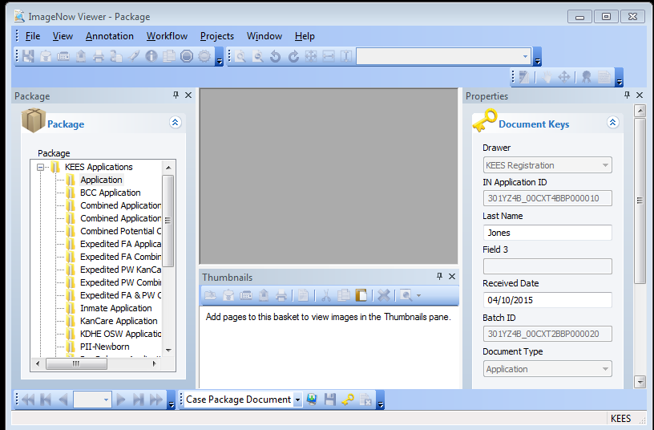
Medical Eligibility: Imaging for DCF Support Staff
Lesson 3: Imaging > Medical Application for the Clearinghouse
On the ImageNow Viewer-Package screen, the Document Keys dialog box will display with the Last Name and Received Date boxes filled in. Workers will need to update the date to the correct received date (must match the date stamp) if they did not do so in the previous step.

Slide 36
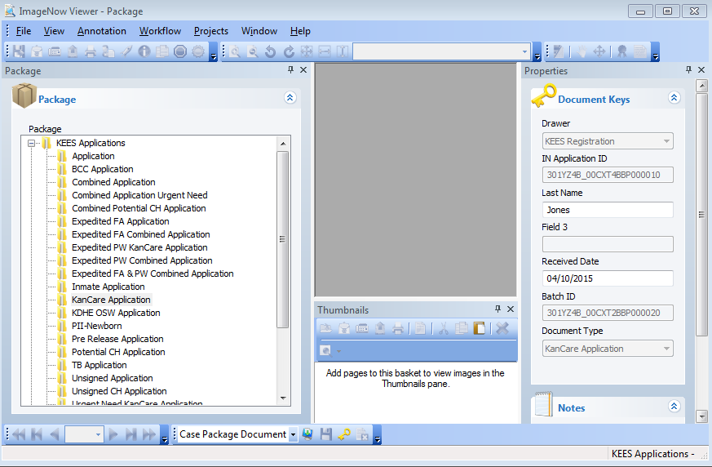
Medical Eligibility: Imaging for DCF Support Staff
Lesson 3: Imaging > Medical Application for the Clearinghouse
Select the appropriate Clearinghouse Document type in the KEES Applications basket (i.e. KanCare Application)

Slide 37
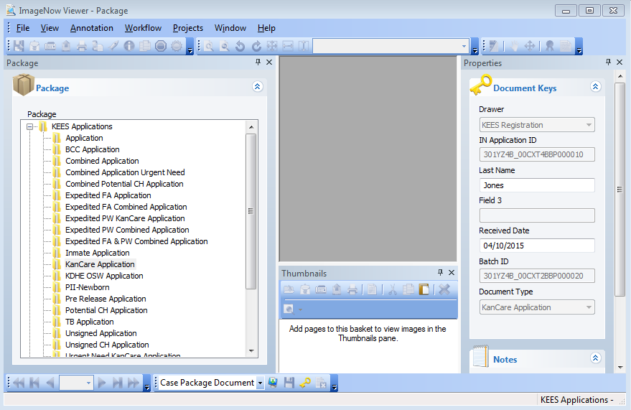
Medical Eligibility: Imaging for DCF Support Staff
Lesson 3: Imaging > Medical Application for the Clearinghouse
Load the application and all the consumer’s supporting paper document in the scanner.
Click the Capture icon on the bottom of the screen.
Notes:
Note: If a worker would like larger icons to display, right click your mouse. When the box appears, left click your mouse on the Customize option. Select the Options tab and click the box next to Large icons in the Other section and then click the Close button.

Slide 38
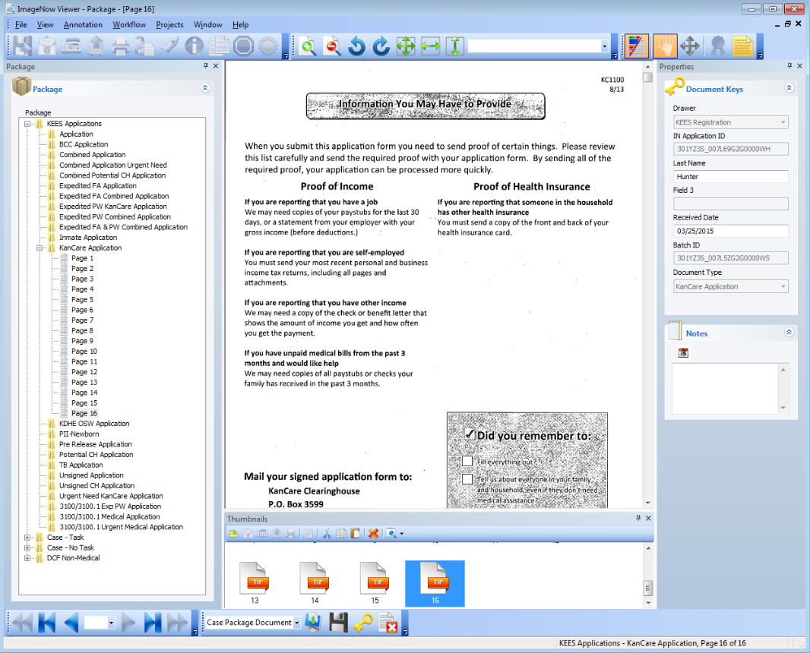
Medical Eligibility: Imaging for DCF Support Staff
Lesson 3: Imaging > Medical Application for the Clearinghouse
The scanned image will go directly into the document type that was selected and will appear in the ImageNow Viewer. Quality Assurance should be used to visually confirm the captured image(s) are of good quality and that all documents are captured and indexed to the correct case information.
Notes:
The user can select Page 1 from the left display and use the arrows to scroll through the pages.

Slide 39
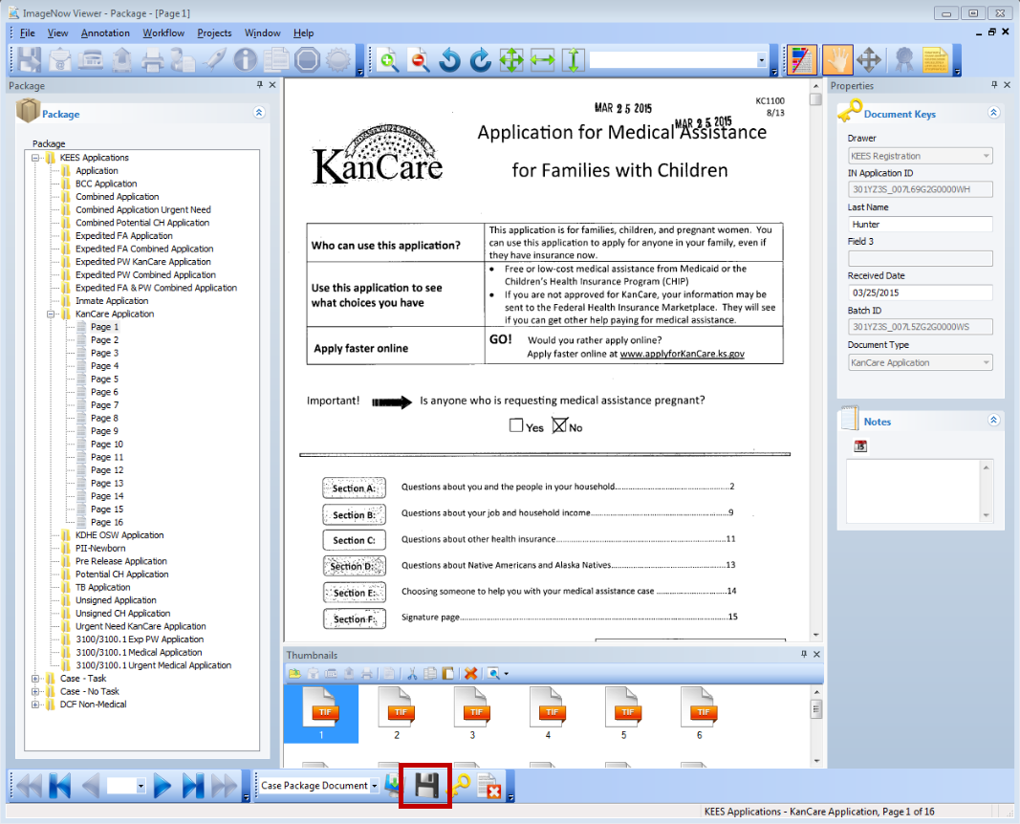
Medical Eligibility: Imaging for DCF Support Staff
Lesson 3: Imaging > Medical Application for the Clearinghouse
Click the Submit button. The document(s) will be indexed to the KEES Registration Documents drawer and a task will be created for the Clearinghouse to register the application.

Slide 40
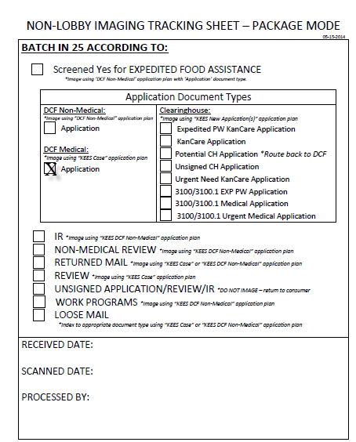
Medical Eligibility: Imaging for DCF Support Staff
Lesson 3: Imaging > DCF Medical Application
DCF Medical Application- Non-Lobby
Place tracking sheet with application in the Registration location.
Up to 25 documents may be attached to one DCF Medical Application Non-Lobby Tracking Sheet based on the day’s mail.
Register and image one client’s application at a time.

Slide 41
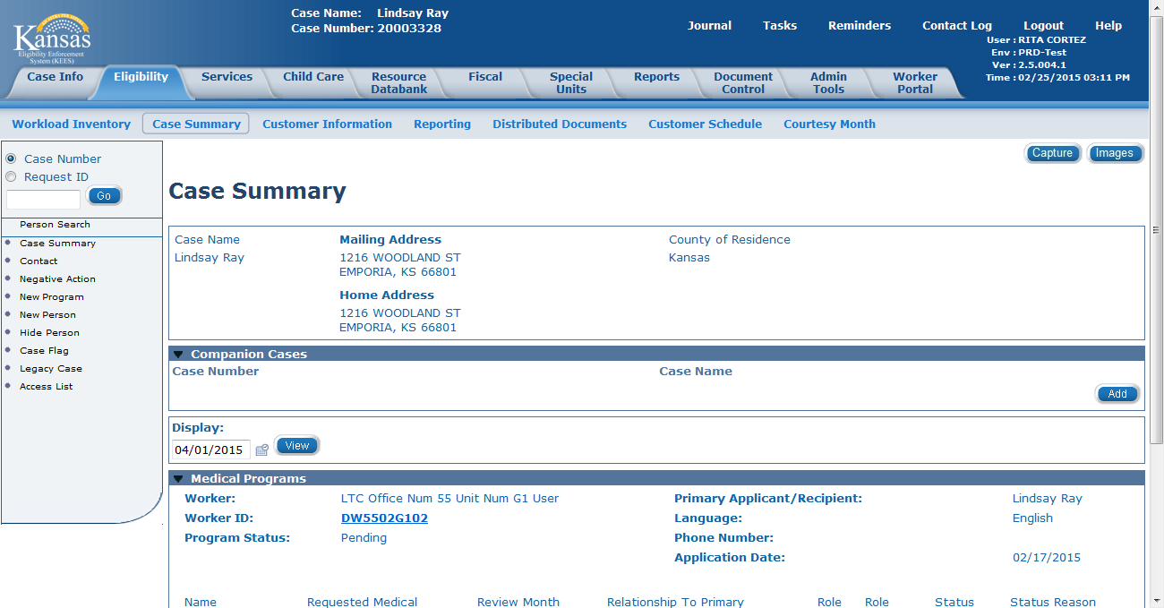
Medical Eligibility: Imaging for DCF Support Staff
Lesson 3: Imaging > DCF Medical Application
Within the context of a KEES case, navigate to the Case Summary page using the KEES Case# assigned during registration. Click the Capture button on the screen.

Slide 42
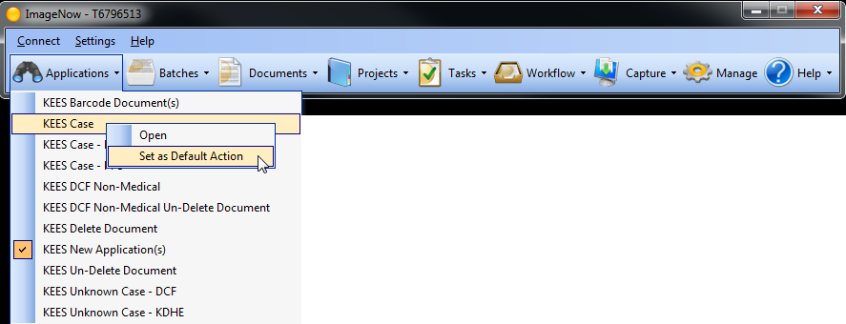
Medical Eligibility: Imaging for DCF Support Staff
Lesson 3: Imaging > DCF Medical Application
On the ImageNow toolbar, locate the Applications drop-down and select KEES Case as the Application Plan default. Always use KEES Case application plan for any document tied to a DCF medical program when the KEES case number is known.
Select the Capture Button after setting the default Application Plan.

Slide 43
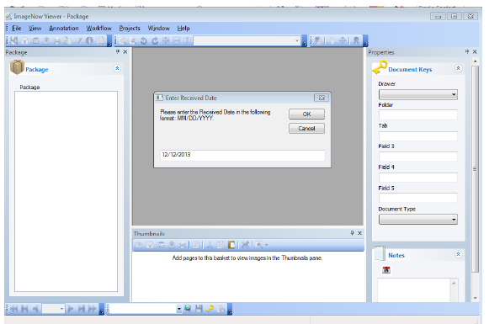
Medical Eligibility: Imaging for DCF Support Staff
Lesson 3: Imaging > DCF Medical Application
Enter Received Date- must match date stamp.

Slide 44
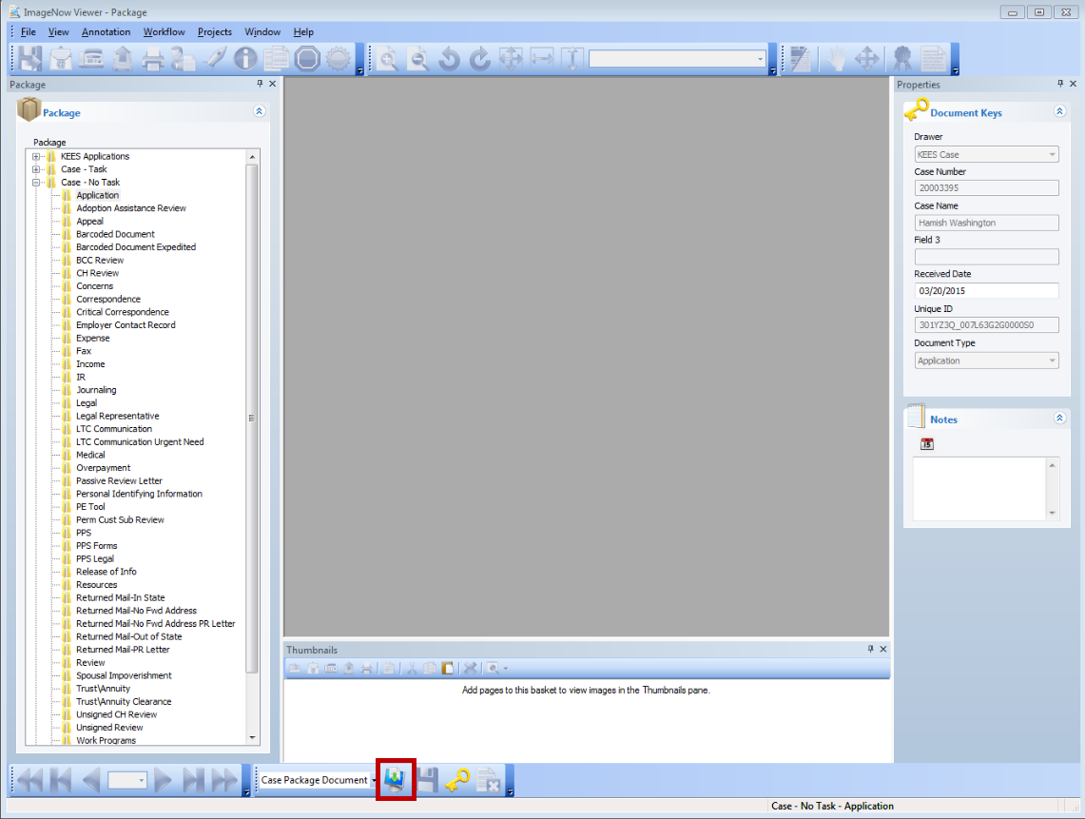
Medical Eligibility: Imaging for DCF Support Staff
Lesson 3: Imaging > DCF Medical Application
Select the Case-No Task drawer and Application document type. Verify that the KEES Case #, Case Name and Received Date are correct. Click the Capture icon on the bottom of the screen.
Notes:
ImageNow is accessing the information on the KEES Case Summary page to complete the Case# and Case Name fields.

Slide 45
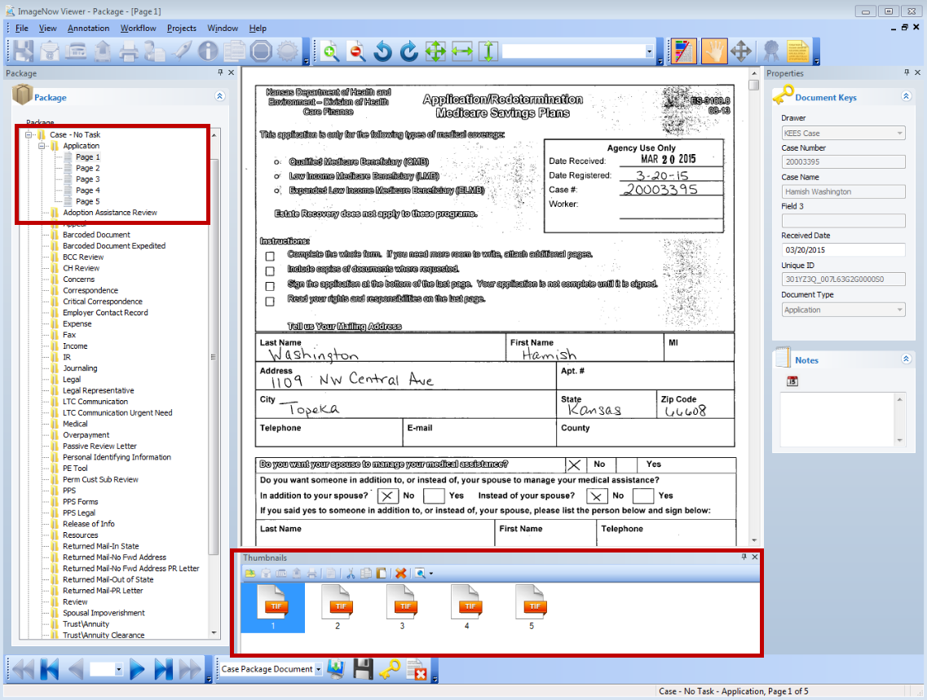
Medical Eligibility: Imaging for DCF Support Staff
Lesson 3: Imaging > DCF Medical Application
The image of the application displays in the ImageNow Viewer. Quality Assurance should be used to confirm the image(s) are of good quality and all documents are captured and indexed to the correct case.
Notes:
A worker should review the images from the left side of the menu instead of the Thumbnail images.

Slide 46
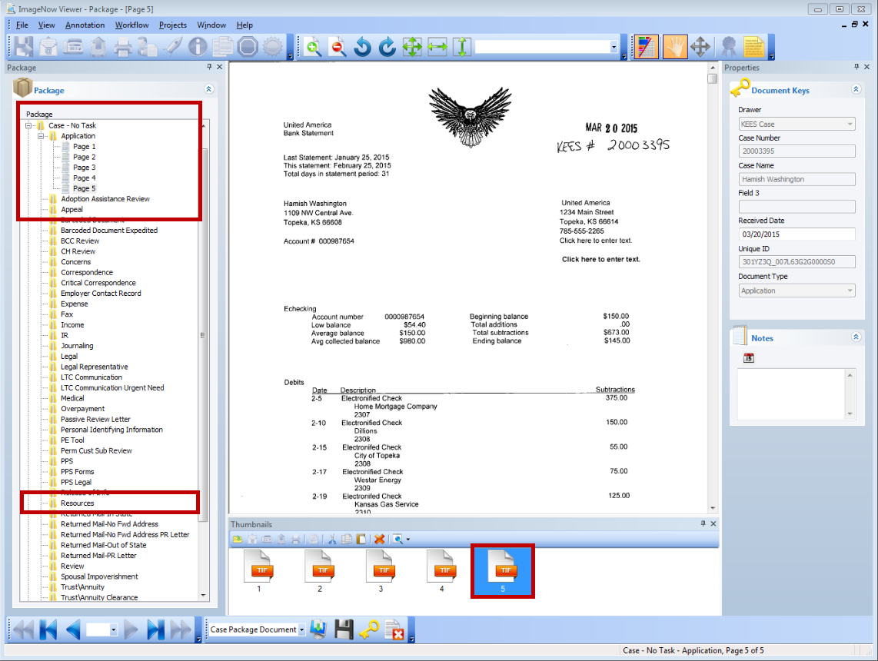
Medical Eligibility: Imaging for DCF Support Staff
Lesson 3: Imaging > DCF Medical Application
If needed, drag and drop the supporting document(s) to their appropriate document type(s). Once everything is correct, click the Submit icon on the bottom of the screen.

Slide 47
Medical Eligibility: Imaging for DCF Support Staff
Summary
We have just learned how to use Imaging for Medical Applications received at the DCF office that need to be routed to the Clearinghouse.
We also learned how to image a DCF application using the Non-Lobby process.
Next we will learn how to use In-Printing when a CAPP application is received.

Slide 48
Medical Eligibility: Imaging for DCF Support Staff
Agenda
Lesson 1: KEES Business Process
Lesson 2: ImageNow Basics
Lesson 3: Imaging
Lesson 4: IN Printing- CAPP Application
Lesson 5: 2nd Level Indexing/Copy a Document

Slide 49
Medical Eligibility: Imaging for DCF Support Staff
Lesson 4: IN Printing > CAPP Application
In Printer:
Utilize the ImageNow virtual printer to capture electronic documents into ImageNow.
Imports a document into ImageNow without printing and scanning first.
Used for CAPP applications
Notes:
Capture Profile – Package Mode
Application Plan- KEES Case

Slide 50
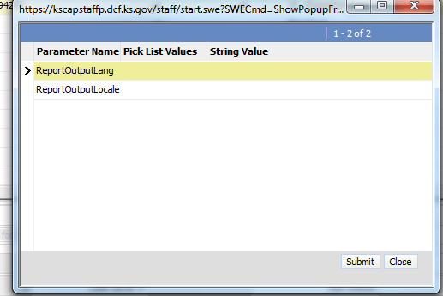
Medical Eligibility: Imaging for DCF Support Staff
Lesson 4: IN Printing > CAPP Application
Access the CAPP system to pull up the application.
Click the Submit button.

Slide 51
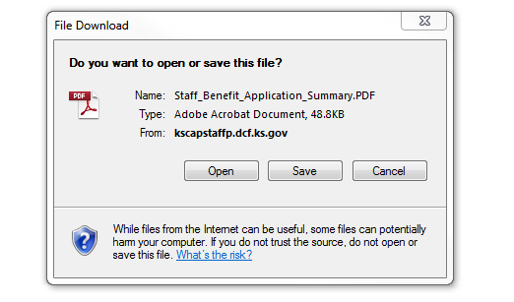
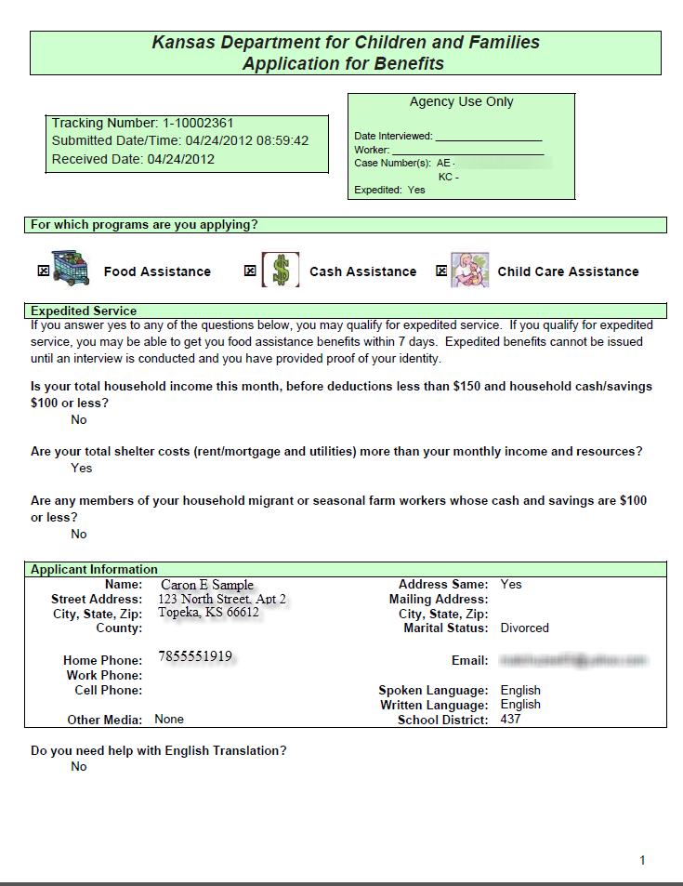
Medical Eligibility: Imaging for DCF Support Staff
Lesson 4: IN Printing > CAPP Application
The File Download dialog box displays. Click Open. The image of the application displays.

Slide 52
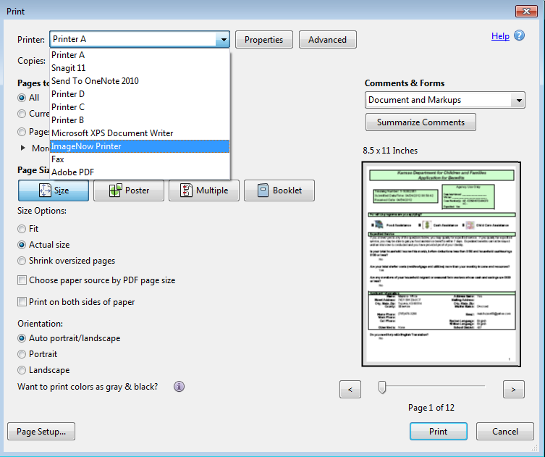
Medical Eligibility: Imaging for DCF Support Staff
Lesson 4: IN Printing > CAPP Application
A worker will need to change their printer to “ImageNow Printer” and then click the Print button on the bottom of the page.
Notes:
The worker will click on File and Print to have the Print Dialog box appear.

Slide 53
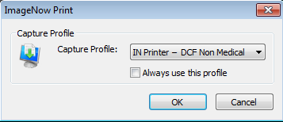
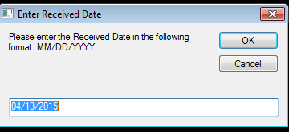
Medical Eligibility: Imaging for DCF Support Staff
Lesson 4: IN Printing > CAPP Application
The Capture Profile dialog box will display. Choose “IN Printer- DCF Non Medical” from the menu drop-down and click the OK button.
The Enter Received Date dialog box will display with the current date populated. Update the date to the received date as applicable.
Notes:
Ensure that the Application Plan matches the document being IN Printed.

Slide 54
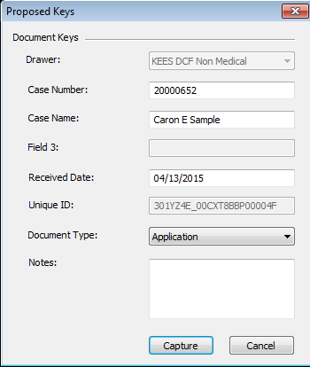
Medical Eligibility: Imaging for DCF Support Staff
Lesson 4: IN Printing > CAPP Application
The Proposed Keys dialog box displays. Enter the Case Number and Case Name. Chose “Application” from the Document Type drop-down menu.
Click the Capture button.

Slide 55
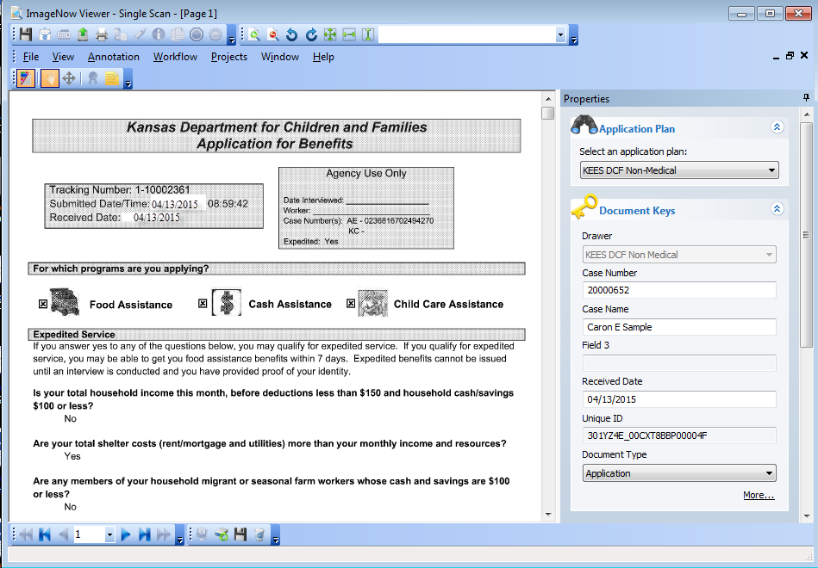
Medical Eligibility: Imaging for DCF Support Staff
Lesson 4: IN Printing > CAPP Application
The image displays in the ImageNow Viewer. The worker will QA the documents and if satisfied with the image(s), will click the Submit icon.

Slide 56
Medical Eligibility: Imaging for DCF Support Staff
Summary
We have just learned how to use the IN Printer mode to capture a CAPP application.
Now we will look at 2nd level indexing for PII (Personal Identifying Information) on medical cases and copying a document.

Slide 57
Medical Eligibility: Imaging for DCF Support Staff
Agenda
Lesson 1: KEES Business Process
Lesson 2: ImageNow Basics
Lesson 3: Imaging
Lesson 4: IN Printing- CAPP Application
Lesson 5: 2nd Level Indexing/Copy a Document

Slide 58
Medical Eligibility: Imaging for DCF Support Staff
Lesson 5: 2nd Level Indexing/Copy a Document > 2nd Level Indexing
2nd Level Indexing:
Required for documents containing Personal Identification Information
These documents are applicable to multiple cases and deemed “durable and portable”
Can only be completed on Medical cases

Slide 59
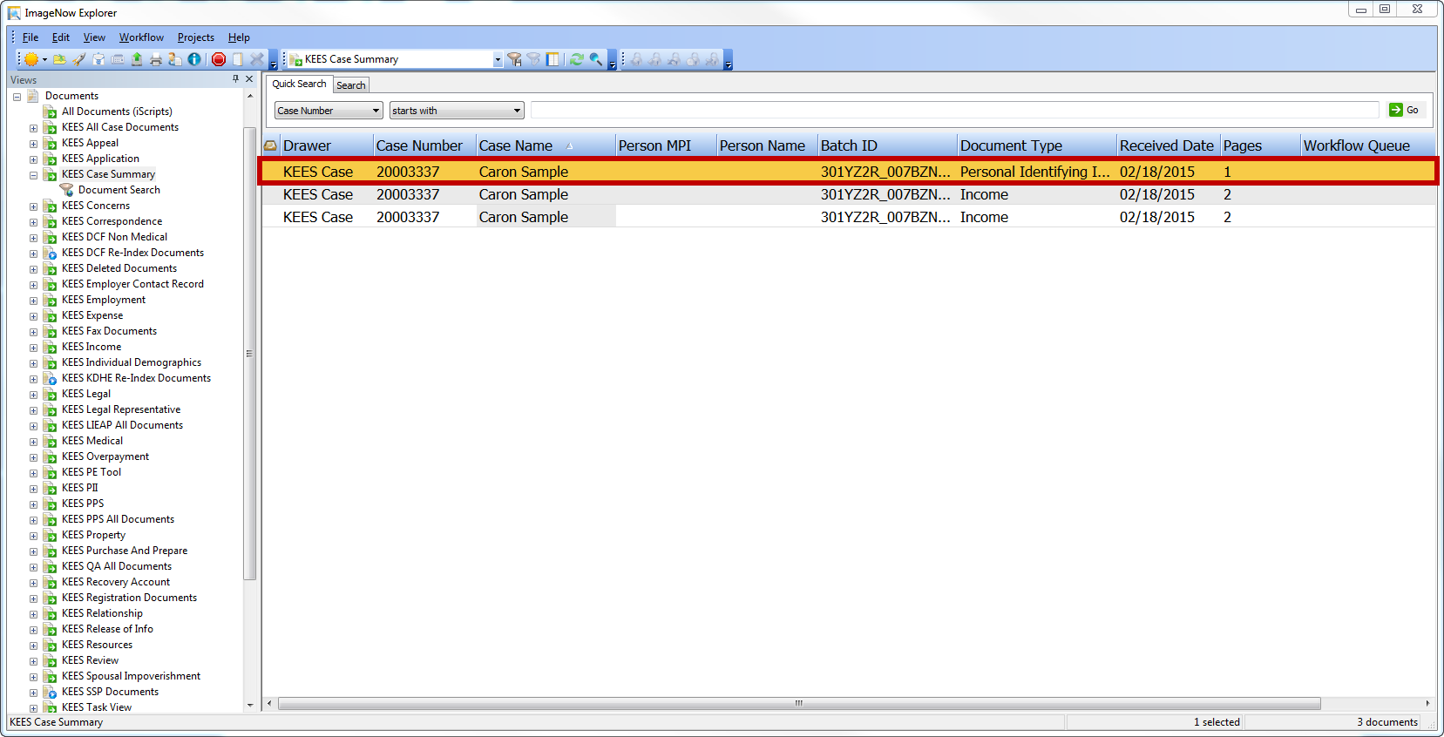
Medical Eligibility: Imaging for DCF Support Staff
Lesson 5: 2nd Level Indexing/Copy a Document > 2nd Level Indexing
Select the PII document by double clicking on the designated line. Image will display in the ImageNow viewer.

Slide 60
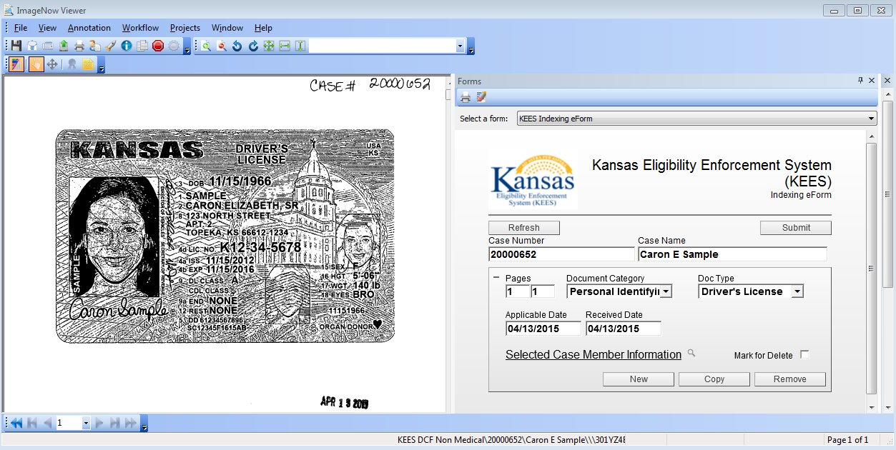
Medical Eligibility: Imaging for DCF Support Staff
Lesson 5: 2nd Level Indexing/Copy a Document > 2nd Level Indexing
The image displays. Click F12 for the Index eForm to display. Select the appropriate values for the document from the Document Category and Doc Type drop-down menus.

Slide 61
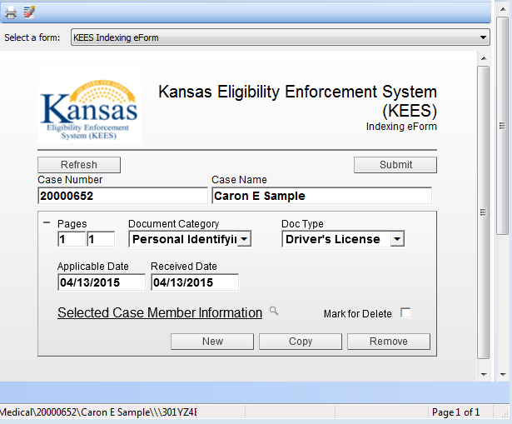
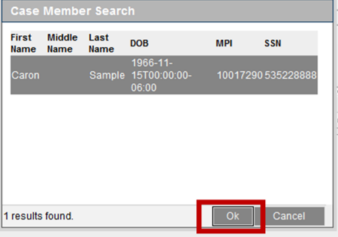
Medical Eligibility: Imaging for DCF Support Staff
Lesson 5: 2nd Level Indexing/Copy a Document > 2nd Level Indexing
Click on the Magnifying Glass to search for the case member information. Case Member Search page displays. Select the correct member and then click the OK. button.

Slide 62
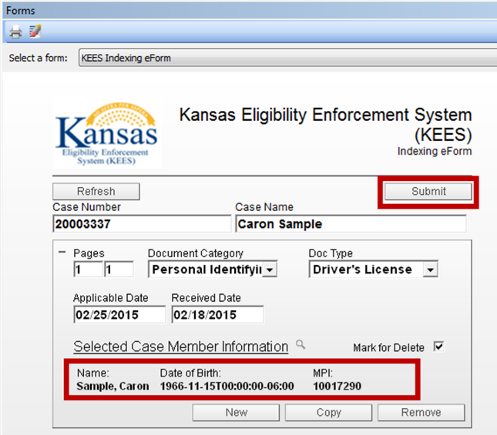
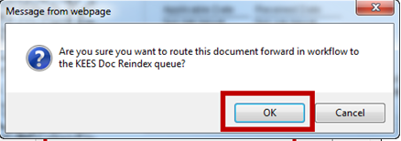
Medical Eligibility: Imaging for DCF Support Staff
Lesson 5: 2nd Level Indexing/Copy a Document > 2nd Level Indexing
Click the Submit button. The Message from webpage dialog box will display. Click the OK button.
Notes:
NOTE: If there are more pages to copy/split from the original image, a worker would need to complete these steps for each image until all are re-indexed.

Slide 63
Medical Eligibility: Imaging for DCF Support Staff
Lesson 5: 2nd Level Indexing/Copy a Document > Retrieve
Once an image has been indexed, it can be re-indexed to another case (e.g. Non-Medical case).
Click on Documents to retrieve all documents stored in ImageNow. Document View allows the user to search for documents that are within a specific, pre-determined criteria and/or security group.

Slide 64
Medical Eligibility: Imaging for DCF Support Staff
Lesson 5: 2nd Level Indexing/Copy a Document > Document View Filter
Document View Filters:
KEES All Case Document- KEES Case related documents
KEES Deleted Documents- Deleted documents performed by the KEES Indexing eForm
KEES Fax Documents- Faxed documents
KEES LIEAP All Documents- KEES Case LIEAP related documents
KEES QA All Documents- KEES QA related documents
KEES Registration Documents- KEES Case Registration related application documents
KEES DCF Non-Medical- DCF Non-Medical related documents
KEES TOP All Documents- KEES TOP related documents
KEES Task View- KEES Tasks related documents for processing
KEES Unknown Case Drawer- KEES documents that were not identified to a KEES Case at the point of capture
KEES PPS All Documents- KEES PPS documents
KEES DCF Re-Index Documents- DCF documents that require Re-indexing to the appropriate case
KEES KDHE Re-Index Documents- KDHE documents that require Re-indexing to the appropriate case
KEES SSP Documents- SSP submitted documents that require indexing to the appropriate document type and/or KEES Case

Slide 65
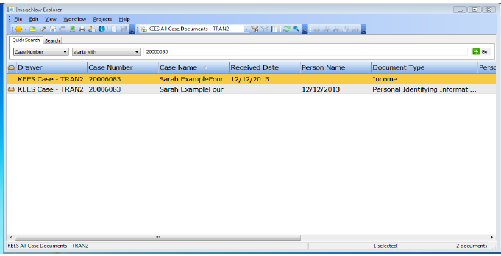
Medical Eligibility: Imaging for DCF Support Staff
Lesson 5: 2nd Level Indexing/Copy a Document > Locate Document
Using ImageNow Document Search, KEES All Case Document document view, locate documents imaged to the KEES case. Enter the KEES case number and click Go. From ImageNow Explorer, open income Document Type by double clicking on the document.

Slide 66
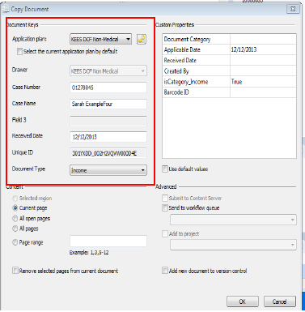
Medical Eligibility: Imaging for DCF Support Staff
Lesson 5: 2nd Level Indexing/Copy a Document > Copy
If the document needs associated to a Non-Medical case, Copy document to the Non-Medical drawer by using File on the ImageNow Viewer, then Copy Document.
Change Application Plan to KEES DCF Non-Medical.
If already selected, a worker MUST reselect the value.
Enter Received date.
Paste KAECSES case# .
Verify Case Name.
Verify appropriate Document Type.
Select OK.
Close ImageNow Viewer to return to ImageNow Explorer.
Employment Verification form has been copied to the Non-Medical income drawer.

Slide 67
Medical Eligibility: Imaging for DCF Support Staff
Lesson 5: 2nd Level Indexing/Copy a Document > Locate and View

Slide 68
Medical Eligibility: Imaging for DCF Support Staff
Summary
We have just learned how to index to the 2nd level for personal identification information on medical cases.
We have also looked at how to locate, retrieve and copy a document.

Slide 69
Medical Eligibility: Imaging for DCF Support Staff
Wrap up
In this course you learned:
KEES Business Processes related to Imaging
ImageNow basics
Imaging related to applications received at the DCF office needing to be routed to the Clearinghouse & for DCF application received through the Non-Lobby Process
IN-Printing for CAPP Applications
Indexing for PII and how to locate, retrieve and copy a document
QUESTIONS?

